Slide 1
Prediabetes Project
PM Meeting, 16/12/24
Notes:
בפגישה הקודמת הצגנו את חשיבות המחקר ולכן בחרנו להתמקד בשיטות שבוצעו במחקר של מתן ומורז שאת עבודתם המשכנו. להבין מדוע הם קיבלו את ההחלטות שלהם ומה נרצה להשאיר ומה לשנות במחקר שלנו.

Slide 2
Introduction

Slide 3
Significance of Early Prediabetes Prediction
Predicting prediabetes, a silent precursor to diabetes and cardiovascular diseases, requires an advanced data-driven approach.
The ability to identify the risk of developing prediabetes is crucial, as it is a lifestyle-based disease that could be potentially prevented with the right intervention.
Notes:
חשיבות אבחון מוקדם של טרום סכרת

Slide 4









Prediabetes Diagnosis
Fasting Plasma
Glucose
2-hour Plasma Glucose On OGTT
Hemoglobin A1C
Diabetes Mellitus
Diabetes Mellitus
Diabetes Mellitus
125 mg/dL
200 mg/dL
6.4%
Prediabetes
Impaired Fasting Glucose
Prediabetes
Impaired Glucose Tolerance
Prediabetes
100 mg/dL
140 mg/dL
5.7%
Normal
Normal
Normal
Adapted from: American Diabetes Association. Diabetes Care. 2014;37 Suppl 1:S81-90.
Notes:
המוגלובין מסוכרר (HBA1c) הוא המוגלובין הקשור למולקולת סוכר.משקף את ממוצע ערכי הסוכר בדם בשלושת החודשים שקדמו לבדיקה באמצעות איזה בדיקות מאבחנים טרום סכרת ובאילו נתמקד לטובת אבחון מטופל הלוקה בטרום סכרת.
הערכים לאבחון כפי שמוצגים כאן מתבססים על ההגדרה של ADA איגוד סכרת אמריקאי. ההגדרה נבחרה לאחר התייעצות עם הצוות הרפואי של כללית כך נהוג לאבחן טרום סכרת בארץ.
גלוקוז אחרי 50 גרם בדיקה לנשים בהריון (בהמשך הוסרו נשים בהריון, את תקופת ההריון שלהן) ולכן בחרנו לא להתמקד בבדיקה זו

Slide 5
Risk Factors
Genetics and Family history
Ethnicity
Age
Overweight
Lack of sport activity
Smoking
Gestational diabetes
Notes:
אלו גורמי סיכון ידועים.
מתוך בסיס הנתונים הוספנו לסט הנתונים שלנו את המאפיינים הדמוגרפיים.
הגורם סיכון האחרון שמצוין לטרום סכרת הינו סכרת הריון ולכן בהמשך הוחלט לוותר על נשים בהריון כדי להתמקד בטרום סכרת "הקלאסי".

Slide 6
Clalit Flowcharts
Notes:
תום סופקו שני תרשימי זרימה על ידי הצוות הרפואי של כללית איתם בוצע המחקר, לבחירת קבוצת החולים והבקרה (מדגם מזווג).

Slide 7
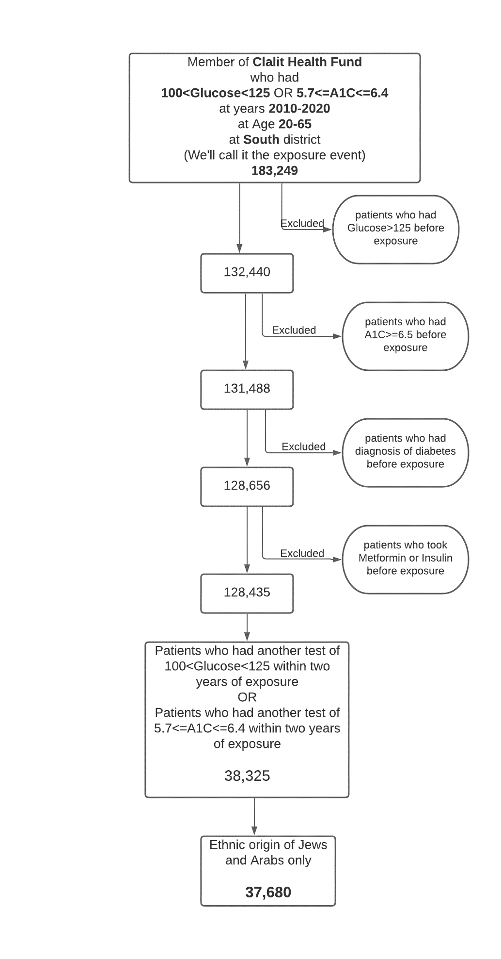
Prediabetes Flowchart
Notes:
תרשים זה מייצג את אופן הבחירה של קבוצת החולים בטרום סכרת (גילאי 20-65 ממגזר יהודי/ערבי).

Slide 8
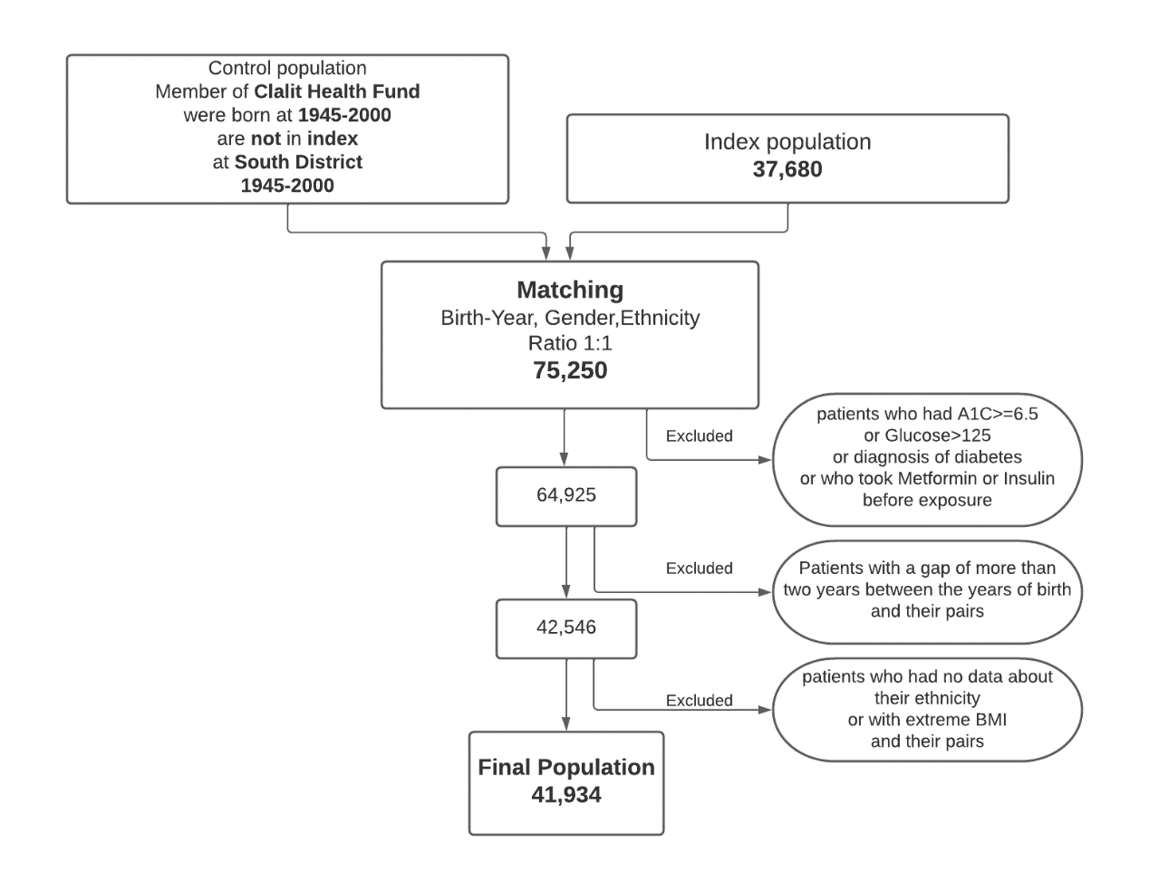
Control Flowchart
Notes:
כיצד לבצע זיווג בין חולים לבקרה ובכך נבחרת קבוצת הבקרה.

Slide 9
Cohort & Control Validation

Slide 10
Pregnancy Period
Laboratory tests performed during pregnancy can potentially result in an incorrect diagnosis of prediabetes. This can occur due to gestational diabetes or other extreme bodily conditions.
1
We used cross-referencing data from the maternity department to identify the tests conducted during pregnancy.
2
This data was then analyzed to determine if the patient still met the criteria for prediabetes diagnosis.
3
After thorough analysis, we identified around 350 female patients who did not meet the criteria for prediabetes diagnosis. Therefore, these patients were moved to the control group.
4
Additionally, approximately 90 female patients did not meet the two-year criterion mention in Section 3.1, but their results approached prediabetes. Following recommendations from the participating doctors, these individuals were excluded from the study cohort.
5
Notes:
אם מישהי אושפזה במחלקת יולדות נמחקו הנתונים 9 חודשים אחורה ממועד הלידה.

Slide 11
Pregnancy Period
Laboratory tests performed during pregnancy can potentially result in an incorrect diagnosis of prediabetes. This can occur due to gestational diabetes or other extreme bodily conditions.
We used cross-referencing data from the maternity department to identify the tests conducted during pregnancy.
This data was then analyzed to determine if the patient still met the criteria for prediabetes diagnosis.
After thorough analysis, we identified around 350 female patients who did not meet the criteria for prediabetes diagnosis. Therefore, these patients were moved to the control group.
Additionally, approximately 90 female patients did not meet the two-year criterion mention in Section 3.1, but their results approached prediabetes. Following recommendations from the participating doctors, these individuals were excluded from the study cohort.

Slide 12
Reference Date
Initially, our task involved validating the study flowchart as designed by Clalit and Soroka. Upon examining the patient cohort, we discovered inconsistencies where several control patients were actually prediabetic. To fix it, we adjusted the diagnosis date to align with the initial prediabetic blood test, removed any prediabetics showing evidence of diabetes, and executed a gender, age, and sector-based matching process to ensure each prediabetes patient had a corresponding control.
Identifying the earliest possible signs of prediabetes for each patient is a goal in order to be able to predict prediabetes before its formal diagnosis date. To accomplish this, a thorough investigation of the original database we got from Clalit was conducted to determine the two earliest laboratory tests that may indicate prediabetes, even before 2010. Through this research, we have identified approximately 4,000 patients who could have been diagnosed with prediabetes earlier.
In addition, the diagnosis of prediabetes by Clalit was determined by two sugar laboratory tests within two years. The date of diagnosis was set to the date of the later test. However, since we wanted to explore the onset of the disease and to be sure we precede prediabetes, we defined the reference date in the study to be the date of the first test (from the two tests that determined that a patient was diagnosed with prediabetes), when the patient shows the first signs of prediabetes.
Notes:
בניגוד להגדרה של כללית למועד האבחון, מורז ומתן החליטו לבחור במועד האבחון המוקדם יותר הרי המטרה שלנו היא לבצע אבחון מוקדם

Slide 13
Prediabetes Flowchart
The study focuses on prediabetes, so to prevent the prediabetes cohort from including patients who already have diabetes before the reference date, a comprehensive process of searching for evidence of diabetes was carried out.
We identified 224 prediabetes patients with evidence of diabetes prescriptions (e.g., Insulin, metformin) before the reference date, 51 patients with laboratory test results that indicate diabetes (glucose levels of 125 mg/dL and above or an A1C of 6.4% and over), and 16 patients with diabetes diagnosis before the reference date. Those patients were removed from the patient cohort.
In addition, 269 patients who were diagnosed based on two laboratory tests from the same date with no other evidence within two years were removed from the cohort since it may be an incorrect diagnosis due to admission extreme information.
Notes:
נרצה שחולה טרום סכרת לא מוגדר כסוכרתי ונשאר בגבולות טרום הסכרת

Slide 14
Control Flowchart
To perform timely analyses and to enable a search for differences between the prediabetes patients and their matched controls, linking the date of diagnosis as a reference for the control allowed an age and gender unbiased and timely analysis, since the matching was done based on age and gender.
A screening process was carried out for control patients with evidence of diabetes or prediabetes before the reference date to allow learning about the differences between the groups and prevent noise and incorrect representation of the control group.
There were 5 controls with laboratory test results indicating diabetes, 158 controls with evidence of diabetes medications, 7 controls with diabetes diagnosis, and one with prediabetes diagnosis. They were removed from the cohort.
There were 403 Control patients who met the prediabetes conditions and thus were control transferred to the prediabetes group.
Notes:
ווידוא בחירת בקרה ללא הטייה של גיל (נבחר בהפרש של לכל היותר שנתיים), מגדר ומגזר זהים
בנוסף, אימות לקבוצת הבקרה שאינם מציגים סימנים של סכרת או טרום סכרת

Slide 15
Minimum Conditions
To learn the progression of diabetes before its diagnosis, two minimum conditions were defined for patient data:
At least two laboratory tests conducted before the reference date to allow the analysis.
The data must be spread over a time span of at least two years before the reference date to study disease progression from early stages.
There were 17,582 prediabetes and 14,478 controls who met these requirements, of which 12,246 matched pairs.
Notes:
הגדרת תנאי המינימום לכניסה של חולים ובקרה למדגם

Slide 16
Matching Process

Slide 17

Final Cohort and Control
After testing both flowcharts, we ended up with a total of 19,682 prediabetes patients and 19,380 control patients
We decided on minimum appearance in data of two lab tests and at least two years in the file
17,582 prediabetes patients and 14,478 controls meeting these minimum conditions were found, of which 12,246 matched pairs
As a result, 13,809 pairs meet all the requirements
A matching process was done by Maximum Bipartite Matching algorithm

Slide 18
Matching Process
To keep patients that can contribute to the research and the ratio 1:1 between prediabetes and control and avoid age, gender, and sector biases, subjects whose matched subjects did not meet the above requirements or moved a group were added to a matching process.
The matching process was performed using the maximum bipartite matching algorithm (Hopcroft & Karp, 1973) to reach the maximum number of matches. Arcs were connected according to the original match conditions (up to two years difference in age, same gender, and sector) between prediabetes patients and controls.
1,738 subjects were matched, but 175 pairs were removed from the cohort because at least one of the subjects in the pair was younger than 20 years old at the reference date, which was an inclusion criterion.
A total of 13,809 matched prediabetes and controls were included in the cohort after meeting all the conditions.

Slide 19
Data Pre-processing
Notes:
גיל

Slide 20
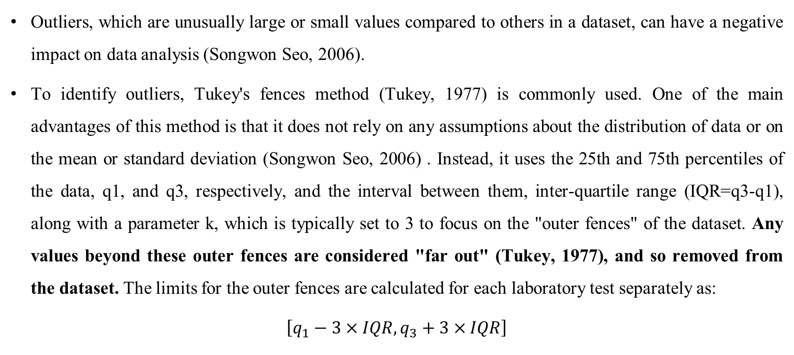
Outliers Detection using Turkey’s Fences
Outliers, which are unusually large or small values compared to others in a dataset, can have a negative impact on data analysis (Songwon Seo, 2006).
To identify outliers, Tukey's fences method (Tukey, 1977) is commonly used. One of the main advantages of this method is that it does not rely on any assumptions about the distribution of data or on the mean or standard deviation (Songwon Seo, 2006) . Instead, it uses the 25th and 75th percentiles of the data, q1, and q3, respectively, and the interval between them, inter-quartile range (IQR=q3-q1), along with a parameter k, which is typically set to 3 to focus on the "outer fences" of the dataset. Any values beyond these outer fences are considered "far out" (Tukey, 1977), and so removed from the dataset. The limits for the outer fences are calculated for each laboratory test separately as:
$$\left[q_{1}−3×IQR,q_{3}+3×IQR\right]$$
Notes:
הוסרו בדיקות מעבדה שחרגו מהגבולות

Slide 21
Data Structure
To compare data based on time before diagnosis, we calculated the time difference (in days) for each record from the reference date.
As part of data preprocessing, we aggregated the records in yearly windows. For instance, each record from all the days before the reference date up to half a year away was aggregated as year '-1'. The average result of each laboratory test for each patient over every year was obtained.
The time period for the aggregation has a trade-off between loss of information and noise. With a too-large interval, there could be a loss of information, while a small interval may add noise to the data. Additionally, there would be more missing values since a short time period would lead to fewer laboratory tests for a patient, which may result in more missed laboratory tests for that time window. In addition, a small window may create a bias towards less healthy patients since they contribute a larger share of data.

Slide 22
Feature Selection

Slide 23
Known Risk Factors – Demographic Features
Family History
Sector
Age
BMI
Notes:
תום

Slide 24
Laboratory Tests Selection
The laboratory test database contains ~76M results of 2,989 different laboratory tests.
Notes:
תום

Slide 25
Motivation for Welch’s t-test
Since not all patients were tested for all laboratory tests in each of the half-years before the diagnosis, there is a different number of control and prediabetes patients who performed a certain test at any time. In order to find laboratory tests with significant differences between the control and the prediabetes in their results, we used Welch t-tests. Welch’s t-test is a robust tool for analyzing data with unequal sample sizes and variances (and unknown variance) (Delacre et al., 2017). It was performed for each laboratory test in each period (half year) before the diagnosis date. For each laboratory test, Welch t-tests were performed for each period separately until there were not enough patients (n=30) tested in the specific laboratory test from each of the study groups. This method led to each laboratory test being tested for different periods.
Notes:
אמנם המדגמים מזווגים – אך הבדיקות קרו בזמנים שונים, ולכן בכל חלון ולכל בדיקה אין מספר מטופלים שווה

Slide 26
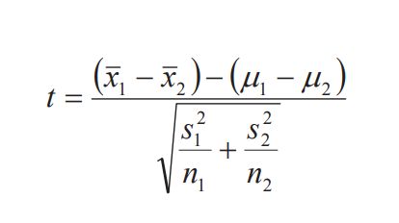
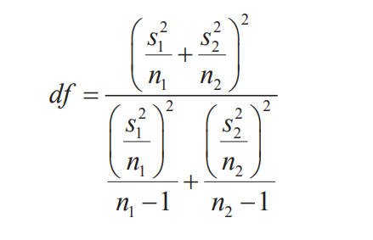
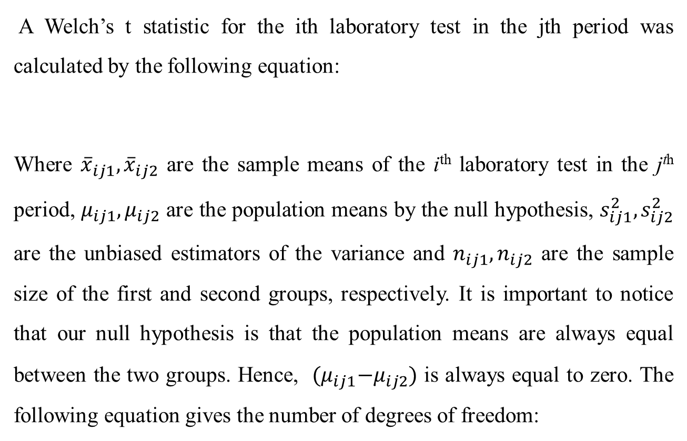
Welch’s t-test
A Welch’s t statistic for the ith laboratory test in the jth period was calculated by the following equation:
Where ${\overline{x}}_{ij1},{\overline{x}}_{ij2}$ are the sample means of the i^{th} laboratory test in the j^{th} period, $μ_{ij1},μ_{ij2}$ are the population means by the null hypothesis, $s_{ij1}^{2}, s_{ij2}^{2}$ are the unbiased estimators of the variance and $n_{ij1},n_{ij2}$ are the sample size of the first and second groups, respectively. It is important to notice that our null hypothesis is that the population means are always equal between the two groups. Hence, ${(μ}_{ij1}−μ_{ij2})$ is always equal to zero. The following equation gives the number of degrees of freedom:

Slide 27
Multiple Comparison Correction
Multiple comparison adjustment is a critical statistical technique used to address the increased risk of Type I errors (false alarms) when performing multiple hypothesis tests simultaneously. The likelihood of detecting false positives increases when analyzing multiple variables or conditions. As stated above, each laboratory test examined a different number of times in this study. Therefore, we applied multiple comparison corrections for each laboratory test separately, based on the number of tests it underwent.
Notes:
גיל

Slide 28
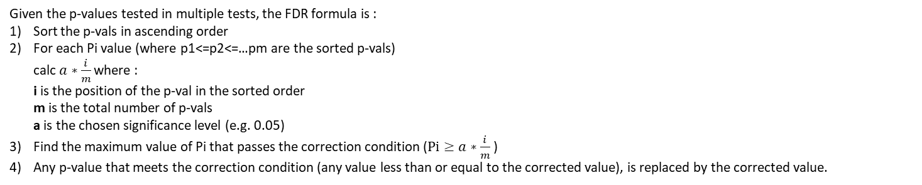
FDR
We used the Benjamini and Hochberg False Discovery Rate (FDR) correction method to correct for multiple comparisons (Benjamini & Hochberg, 1995) as we performed; the significance is reported based on the adjusted P value from the FDR (adjusted p<0.05 considered significant). To assess the statistical significance of each laboratory test, we examined the consecutive periods (half years) leading up to the date of diagnosis. Our analysis aimed to determine the number of consecutive periods until the diagnosis in which the test shows statistical significance, allowing for a maximum of one non-significant period. This approach provided insights into the temporal pattern of significance for each laboratory test concerning the diagnosis date.
Given the p-values tested in multiple tests, the FDR formula is :
Sort the p-vals in ascending order
For each Pi value (where p1<=p2<=…pm are the sorted p-vals) calc $a∗\frac{i}{m}$ where : i is the position of the p-val in the sorted order m is the total number of p-vals a is the chosen significance level (e.g. 0.05)
Find the maximum value of Pi that passes the correction condition ($Pi≥a∗\frac{i}{m}$ )
Any p-value that meets the correction condition (any value less than or equal to the corrected value), is replaced by the corrected value.
Notes:
P(No False Positives)=(1−0.05)^20≈0.36 P(At Least One False Positive)=1−0.36=0.64

Slide 29
Boostraping
p-values are sensitive to the sample size, as a larger sample size tends to yield smaller p-values, which can sometimes lead to the appearance of statistical significance, even for relatively minor effects (Sullivan & Feinn, 2012). This issue is particularly relevant when dealing with common laboratory tests (e.g., blood count tests), which often involve large sample sizes.
A bootstrapping methodology was employed to address the challenge of sample size sensitivity and ensure that significance is not artificially detected. Bootstrapping is a resampling technique used to estimate the distribution of statistics by repeatedly drawing random samples with replacement from the original data set.
Notes:
תום

Slide 30
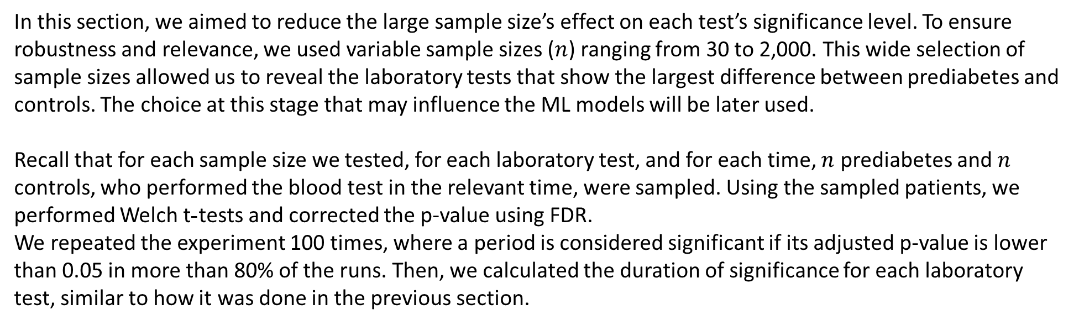
Welch’s t-tests with different sample sizes and bootstrapping
In this section, we aimed to reduce the large sample size’s effect on each test’s significance level. To ensure robustness and relevance, we used variable sample sizes ($n$) ranging from 30 to 2,000. This wide selection of sample sizes allowed us to reveal the laboratory tests that show the largest difference between prediabetes and controls. The choice at this stage that may influence the ML models will be later used.
Recall that for each sample size we tested, for each laboratory test, and for each time, $n$ prediabetes and $n$ controls, who performed the blood test in the relevant time, were sampled. Using the sampled patients, we performed Welch t-tests and corrected the p-value using FDR.
We repeated the experiment 100 times, where a period is considered significant if its adjusted p-value is lower than 0.05 in more than 80% of the runs. Then, we calculated the duration of significance for each laboratory test, similar to how it was done in the previous section.
Notes:
תקופה נחשבה כSIGNIFCANT רק אם ב80% מתוך 100 הריצות הPVAL היה קטן מ0.05
מבחן סטטיסטי לבדיקת המובהקות בין החולים לבקרה בכל בדיקת מעבדה, כאשר גדלי המדגם והשונות שונים.

Slide 31
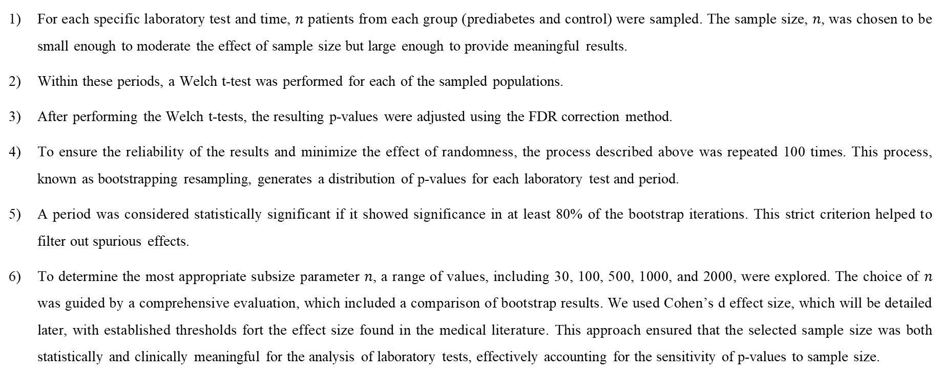
Steps Breakdown
For each specific laboratory test and time, $n$ patients from each group (prediabetes and control) were sampled. The sample size, $n$, was chosen to be small enough to moderate the effect of sample size but large enough to provide meaningful results.
Within these periods, a Welch t-test was performed for each of the sampled populations.
After performing the Welch t-tests, the resulting p-values ​​were adjusted using the FDR correction method.
To ensure the reliability of the results and minimize the effect of randomness, the process described above was repeated 100 times. This process, known as bootstrapping resampling, generates a distribution of p-values ​​for each laboratory test and period.
A period was considered statistically significant if it showed significance in at least 80% of the bootstrap iterations. This strict criterion helped to filter out spurious effects.
To determine the most appropriate subsize parameter $n$, a range of values, including 30, 100, 500, 1000, and 2000, were explored. The choice of $n$ was guided by a comprehensive evaluation, which included a comparison of bootstrap results. We used Cohen’s d effect size, which will be detailed later, with established thresholds fort the effect size found in the medical literature. This approach ensured that the selected sample size was both statistically and clinically meaningful for the analysis of laboratory tests, effectively accounting for the sensitivity of p-values ​​to sample size.
Notes:
מקובל להתחיל עם 30 כמספר מאגי והבחירה של גדלי המדגם השונים היא לפי הספרות

Slide 32
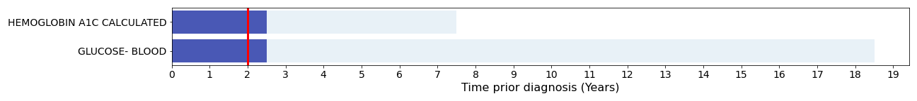
Welch’s t-tests with bootstrapping, n=30
Figure 1: : Laboratory test results with a significance of 2 years (red vertical line) or above using the bootstrapping method with n=30
Notes:
בציר ה-X חצאי שנה לפני האבחון כדי שיוכלו לחזות בצורה מהימנה את טרום הסכרת בציר ה-Y מופיעות בדיקות המעבדה השונות
הערכים מסמנים האם בשנה שלפני מועד האבחון (2- חצאי שנים) הבדיקה נמצאה כמובהקת (ב-80% מהריצות באותה חצי שנה)
ערך הסף שמבחינתנו הבדיקות שחוצות אותו (מסומן בקו אדום) הן מעניינות, בחירה שרירותית, מוגדר להיות 2 חצאי שנים (שנה אחת שבה הבדיקה נמצאה מובהקת)
בר בהיר הוא מכמה תקופות זמן לפני היה לנו מספיק נתונים כדי לבצע את הבדיקה וההשוואה
עבור כל תקופה ובדיקת מעבדה דגמנו 30 רשומות 100 פעמים
כאן ניתן לראות כי שתי הבדיקות המעניינות הן הבדיקות שלפיהן מוגדר טרום סכרת – A1C ו-FGR (בדיקת גלוקוז בצום)
הבדיקות שציפינו שיופיעו ראשונות לפי אוכלוסיית מחקר בטרום סכרת אלו שני מדדי הסוכר, כבר בגודל מדגם 30 ניתן להראות כי בדיקות אלו משמעותיות.

Slide 33
Welch’s t-tests with bootstrapping, n=30
As shown in Figure 1, only two laboratory tests show two or more significant years, and unsurprisingly, these are the two blood markers that define prediabetes: blood glucose and HbA1c. Both showed 2.5 years of significance, where HbA1c was tested for 7.5 years before diagnosis and blood glucose was tested for 18.5 years, according to the periods when enough patients existed to perform the test. These results clearly indicate that the sample size of 30 patients from each research group is too small, too rigid, and does not lead to informative results in favor of feature selection.

Slide 34
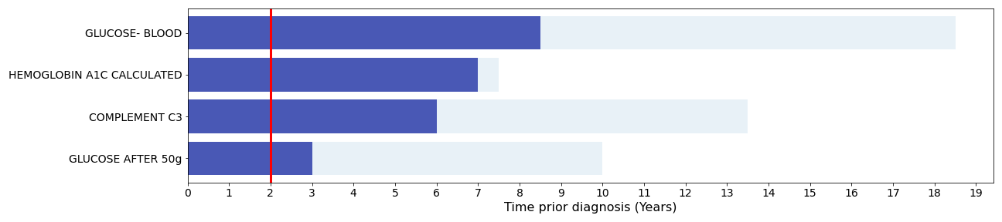
Welch’s t-tests with bootstrapping, n=100
Figure 2: Laboratory test results with a significance of 2 years (red vertical line) or above using the bootstrapping method with n=100
Notes:
כאן ניתן לראות כי מספר הבדיקות המעניינות שנמצאו מעניינות לפחות שנה לפני מועד האבחון הן לא רק A1C וגלוקוז (כפי שראינו עבור n=30), אלא גם C3, טריגליצדרידים, גלוקוז אחרי 50 גרם (גלוקוז מסוכרר), VLDL וגם המוגלובין.

Slide 35
Welch’s t-tests with bootstrapping, n=100
As shown in Figure 2, four laboratory tests were found to be significant using a sample size of 100 patients. The two markers from the previous sample size were again obtained, in addition to glucose after 50g, a test that is used to detect gestational diabetes and is done for pregnant women only, and C3, which is a protein in the complement system, the level of which increases in situations of inflammation and in stressful situations. The entry of glucose after 50g is not surprising; thus, all blood tests related to sugar were found to be important in relatively small sample sizes. On the other hand, the entry of C3 into the important tests is interesting since this marker is not known to be a factor related to diabetes or prediabetes. The current sample size extended the duration of significance of blood glucose and HbA1c, from 2.5 years each to 8.5 years and 7 years, respectively. Still, despite the entry of C3 into the group of important tests, blood tests known in the literature such as those based on a lipid profile have not yet shown two or more years of significance. Therefore, this sample size might also be insufficient and should be increased.

Slide 36
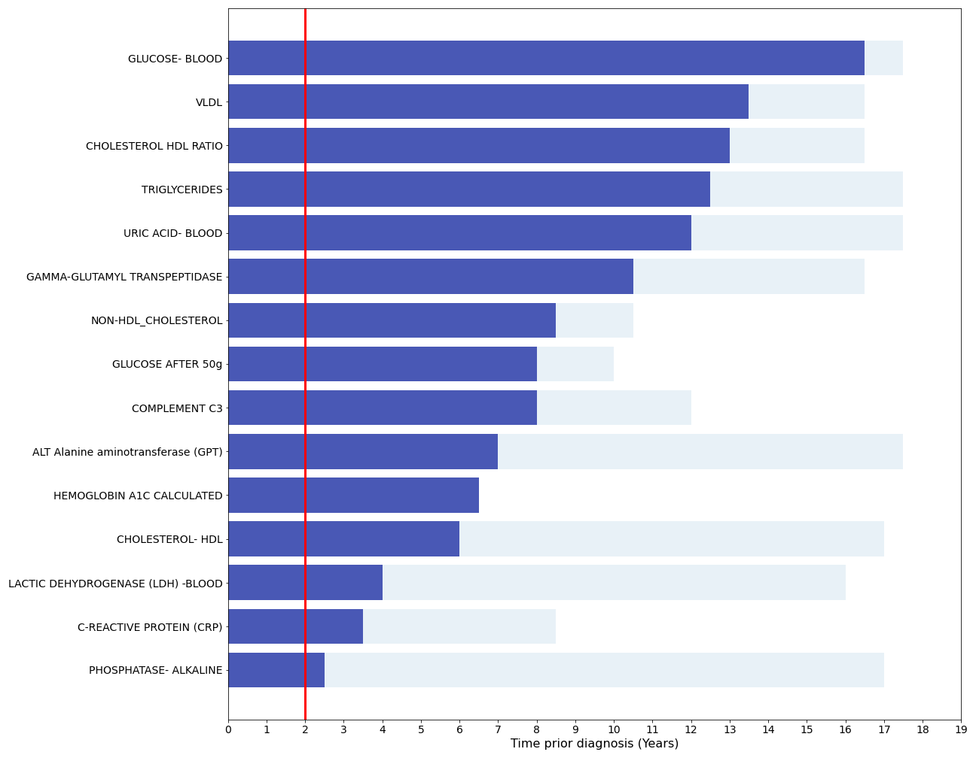
Welch’s t-tests with bootstrapping, n=500
Figure 3: Laboratory test results with a significance of 2 years (red vertical line) or above using the bootstrapping method with n=500

Slide 37
Welch’s t-tests with bootstrapping, n=500
As shown in Figure 3, when testing a sample size of n=500, 11 additional tests are added to the previous four identified laboratory tests. The tests that are added are VLDL, cholesterol-HDL ratio, triglycerides, non-HDL cholesterol, and HDL cholesterol from the lipid profile, blood uric acid, gamma GT, ALT-GPT, LDH, CRP, and phosphatase alkaline.
The addition to the sugar markers of the lipid profile tests, ALT-GPT and uric acid, which are known in the medical literature as markers associated with diabetes and prediabetes (Fraser et al., 2009; Kansal & Kamble, 2016; Katsiki et al., 2013) might indicate that this is the best sample size to use to further explore.

Slide 38
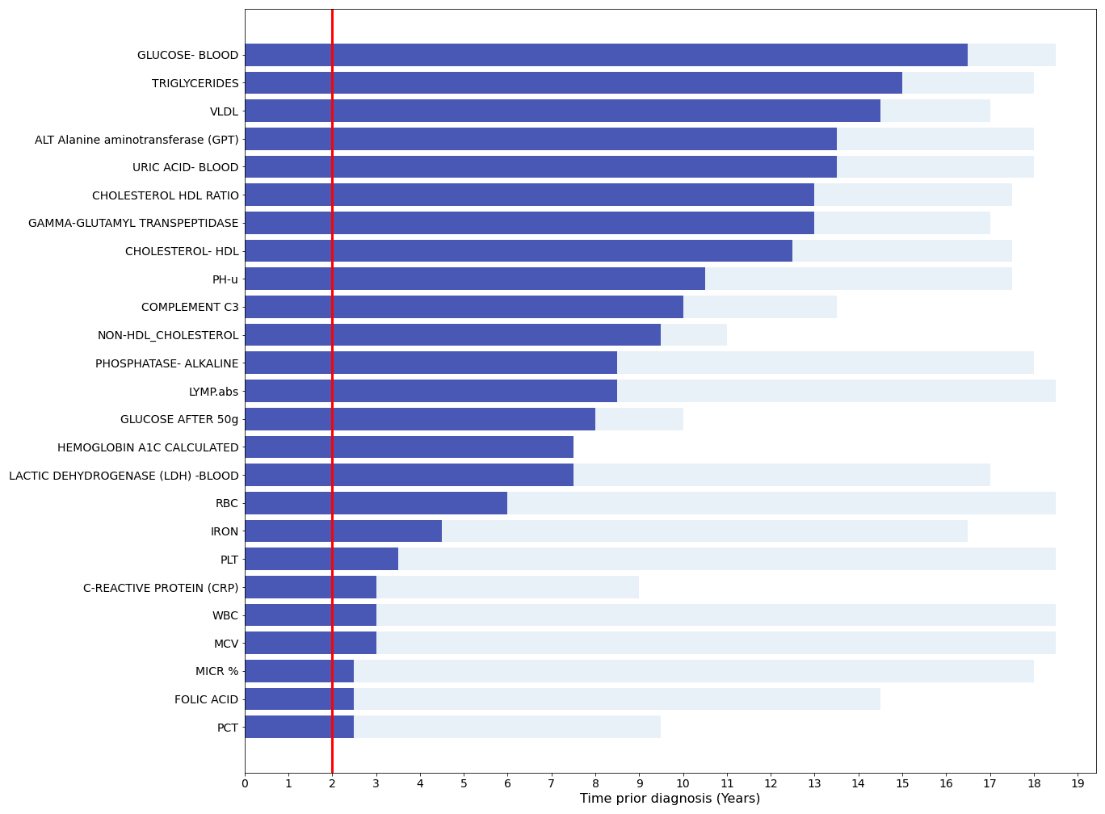
Welch’s t-tests with bootstrapping, n=1000
Figure 4: Laboratory test results with a significance of 2 years (red vertical line) or above using the bootstrapping method with n=1000
Notes:
כאן ניתן לראות כי מספר הבדיקות המעניינות שנמצאו מעניינות לפחות שנה לפני מועד האבחון גדל ומתווספות הבדיקות הבאות: כולסטרול HDL RATIO, GAMMA, URIC ACID, כולסטרול NON HDL, כולסטרול HDL, ALT GPT, RBC, לימפוציטים, PHOSOPHATE ALKALINE, LDH, IRON, PH-u, CRP, LUC, מגנזיום, DHEA SULPHATE, WBC.
בדיקות מובהקות יותר מ-10 שנים לפני מועד האבחון: גלוקוז, טריגליצרידים, VLDL, כולסטרול HDL RATIO, GAMMA, C3, URIC ACID, כולסטרול NON HDL.

Slide 39
Welch’s t-tests with bootstrapping, n=1000
As shown in Figure 4, for a sample size of 1000, it can be seen that common laboratory tests, mainly blood counts, enter the list of important tests. We estimate that this is the stage where the increase in the sample size should be interrupted, as there is a high probability that laboratory tests that will enter from this stage and onwards may add noise to the model and harm the learning task later on.

Slide 40
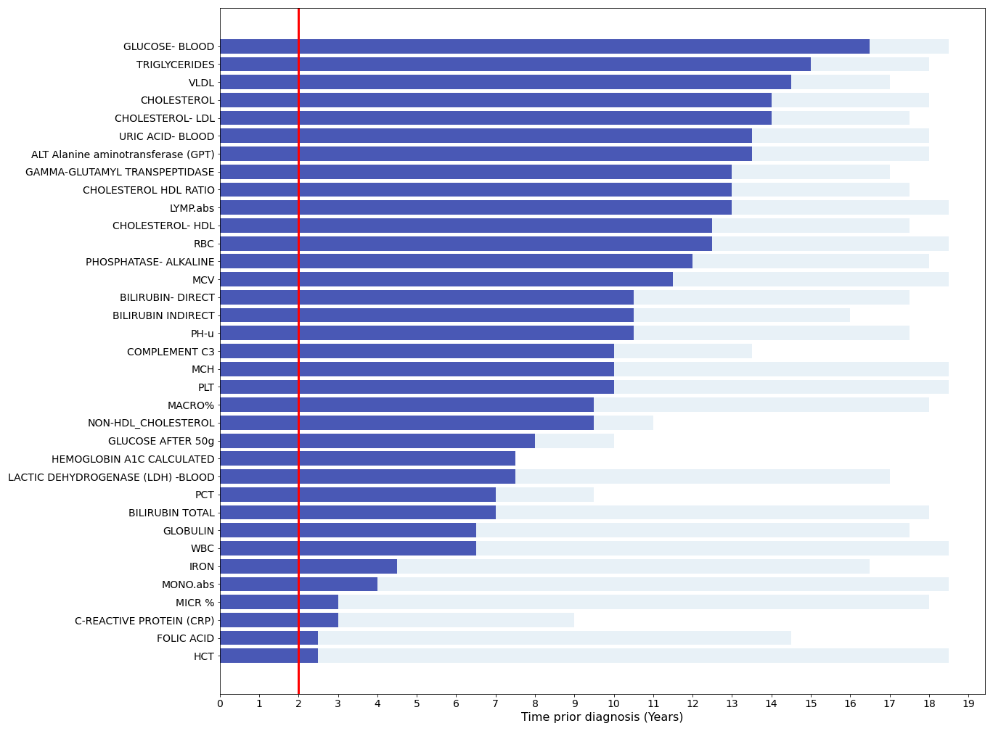
Welch’s t-tests with bootstrapping, n=2000
Figure 5: Laboratory test results with a significance of 2 years (red vertical line) or above using the bootstrapping method with n=2000
Notes:
מראים עוד יותר רעש! מציג מובהקות איפה שלא מעניין אותנו, מציג הבדלים קטנים ולא רלוונטיים.
למשל, כדוריות דם אדומות מובהקות כבר 10-12 שנים לפני מועד האבחון.
מדובר על גודל מדגם מאוד מאוד גדול שמפריע לוולש ומציג מובהקות איפה שלא מעניין אותנו.

Slide 41
Welch’s t-tests with bootstrapping, n=2000
To be safe, we also tested a sample size of 2,000, although we thought it would be inappropriate to increase it even to 1,000. As seen in Figure 9, increasing the sample size to 2000 adds more common tests that we suspect may be less discriminating. Therefore, the final sample size based on which we defined the important laboratory tests is 500.

Slide 42
Cohen’s d
After dealing with the limitation of sample size on the p-value by bootstrapping, the correctness of the chosen sample size was validated using another important aspect that sheds light on the differences between the groups, i.e., the size of the effect.
Although the p-value can indicate whether an effect exists, it does not reveal the magnitude of the effect.
Therefore, both the substantive significance (effect size) and the statistical significance (p-value) were considered crucial to search for the distinctive laboratory tests (Sullivan & Feinn, 2012).
Notes:
זו שיטה לבחון את הנכונות של גודל המדגם הנבחר (n=500) – מהמבחן שביצענו קודם לכן ניתן היה לראות אם קיים אפקט של הבדיקה אך לא את גודל האפקט. לכן, כדי לקבוע שאכן בדיקה מבחינה בין חולים לבקרה צריך לא רק לבחון את המובהקות הסטטיסטית אלא גם גודל האפקט שלה הוא מספיק גדול.
המוטיבציה שמבחני וולש מאוד טובים במציאת הבדלים בין שתי קבוצות החולים והבריאים ומחפש לבדוק האם ההפרש הזה גדול ממשהו, נפוץ לבדוק האם ההפרש הזה שונה מאפס ואם הוא אכן שונה מאפס אזי עבור גודל מדגם מספיק גדול ההבדל יצא מובהק.

Slide 43
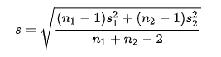
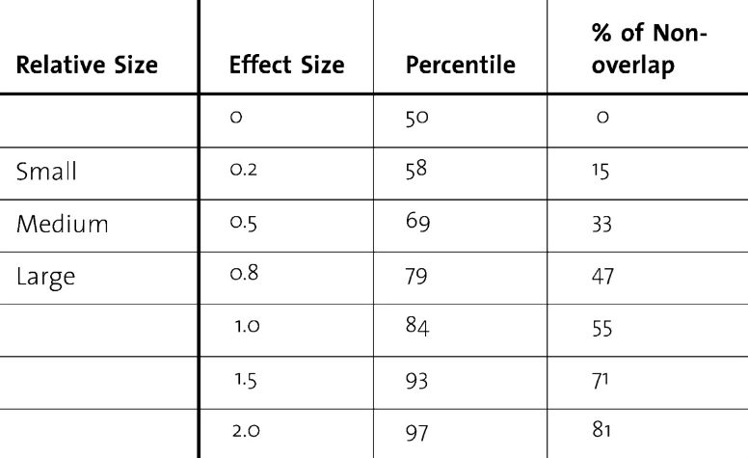
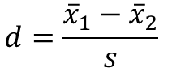
Cohen’s d
Cohens d is a standardized effect size for measuring the difference between two group means
$$d={\frac{{\overline{x}}_{1}−{\overline{x}}_{2}}{s}}_{}$$
Notes:
כאן אנו דורשים שההבדל (הפרש תוחלות) יהיה מספיק גדול (הבדל גדול מ-0), הפרש תוחלות משמעותי דיו, ומשמעותי יחסית לשונות (פיזור הטבעי של המשתנה). אנו דורשים שההפרש התוחלות יהיה מספיק גדול ומשמעותי לפי ערך שנגדיר בעזרת Cohen’s d. מחושב באופן הבא: נקח ממוצע של קבוצת החולים ומחסירים ממנו את הממוצע של קבוצת הבריאים ומחלקים הפרש זה באומד לסטיית התקן המשותפת.
מכאן מתקבל ערך d שמצביע על כמה סטיות תקן משותפות הממוצעים רחוקים אחד מהשני?
ככל שערך d גדול יותר כך ניתן לומר שהבדיקה מעניינת יותר.
טבלה מהספרות שלפיה מתוארות ההנחיות לפירוש התוצאות:
0.2 גודל יחסי נמוך, 0.5 בינוני ו-0.8 ומעלה הבדל גדול.

Slide 44
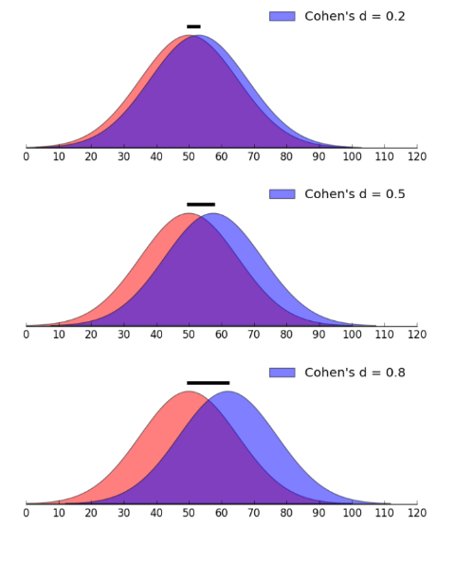
Cohen’s d
Cohens d is a standardized effect size for measuring the difference between two group means
$$d={\frac{{\overline{x}}_{1}−{\overline{x}}_{2}}{s}}_{}$$
Notes:
ישנן כמה דוגמאות של Cohen’s d לגודל אפקט, ניתן לראות שתי התפלגויות כחולה ואדומה.
ניתן לראות כי כאשר Cohen’s d גודל אפקט 0.2 ישנו 15% של אי חפיפה בין ההתפלגויות, כאשר עולה ל-0.5 ישנו 33% של אי חפיפה ואילו עבור 0.8 ישנו 47% של אי חפיפה. כלומר, ככל שגודל Cohen’s d גדל כך גודל האפקט גדל אז ניתן לומר שההתפלגויות מאוד שונות אחת מהשנייה ויהיה לנו יחסית קל בהינתן דגימה חדשה להגיע מאיפה היא הגיעה. במיוחד ככל שגודל המדגם גדל.

Slide 45

Cohen’s d in biomedical researches
Cohen (1988) provided guidelines for effect size interpretation
Small, medium and large effect sizes were recommended to be 0.2, 0.5 and 0.8 respectively
Brydges (2019) claimed that for biomedical researches the suitable guidelines are 0.12, 0.26, 0.49
Notes:
במחקרים של רפואה וביולוגים רואים באופן סיסטמתי אפקט גדלים size קטנים יותר.
לכן, בתחומים אלה וגם במחקר שלנו צריך להגדיר ערכי סף לגודל יחסי (קטן, בינוני וגדול) יותר נמוכים מאלו שהוצעו ע"י Cohen’s d.
לרוב משתמשים ב-Cohen’s d במחקרים כאלו ולכן נצטרך לבצע התאמות נדרשות, בניסויים בהם מבצעים טיפול/פעולה ואז רואים את גודל האפקט.
אצלנו אין פעולה, אלא מסתכלים על דברים שקרו לפני האבחון.
ברידג'ס ב-2019 נתן הנחייה של 0.12 לאפקט קטן, 0.26 לאפקט בינוני ו-0.49 לאפקט גדול

Slide 46
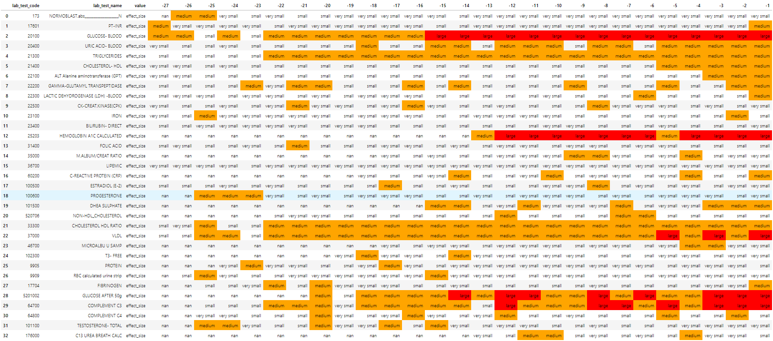
Cohen’s d
Notes:
ברידג'ס ב-2019 נתן הנחייה של 0.12 לאפקט קטן, 0.26 לאפקט בינוני ו-0.49 לאפקט גדול
עבור כל בדיקת מעבדה ניתן לראות את גודל האפקט (קטן מאוד, קטן, בינוני או גבוה) לאורך חצאי השנים לפני האבחון.

Slide 47
Cohen’s d – Heatmap
The heatmap graph below displays the results of Cohen's d for laboratory tests selected in the preliminary stage and bootstrapping analysis. The Y-axis shows the names of laboratory tests, while the X-axis represents the period for which the effect size was calculated. Each cell color represents Cohen's d result of the test appearing on the Y-axis and the period appearing on the X-axis. The color legend is displayed in the bar next to the plot. Periods where Cohen's d was not calculated due to an unrepresentative number of data are shown in white.

Slide 48
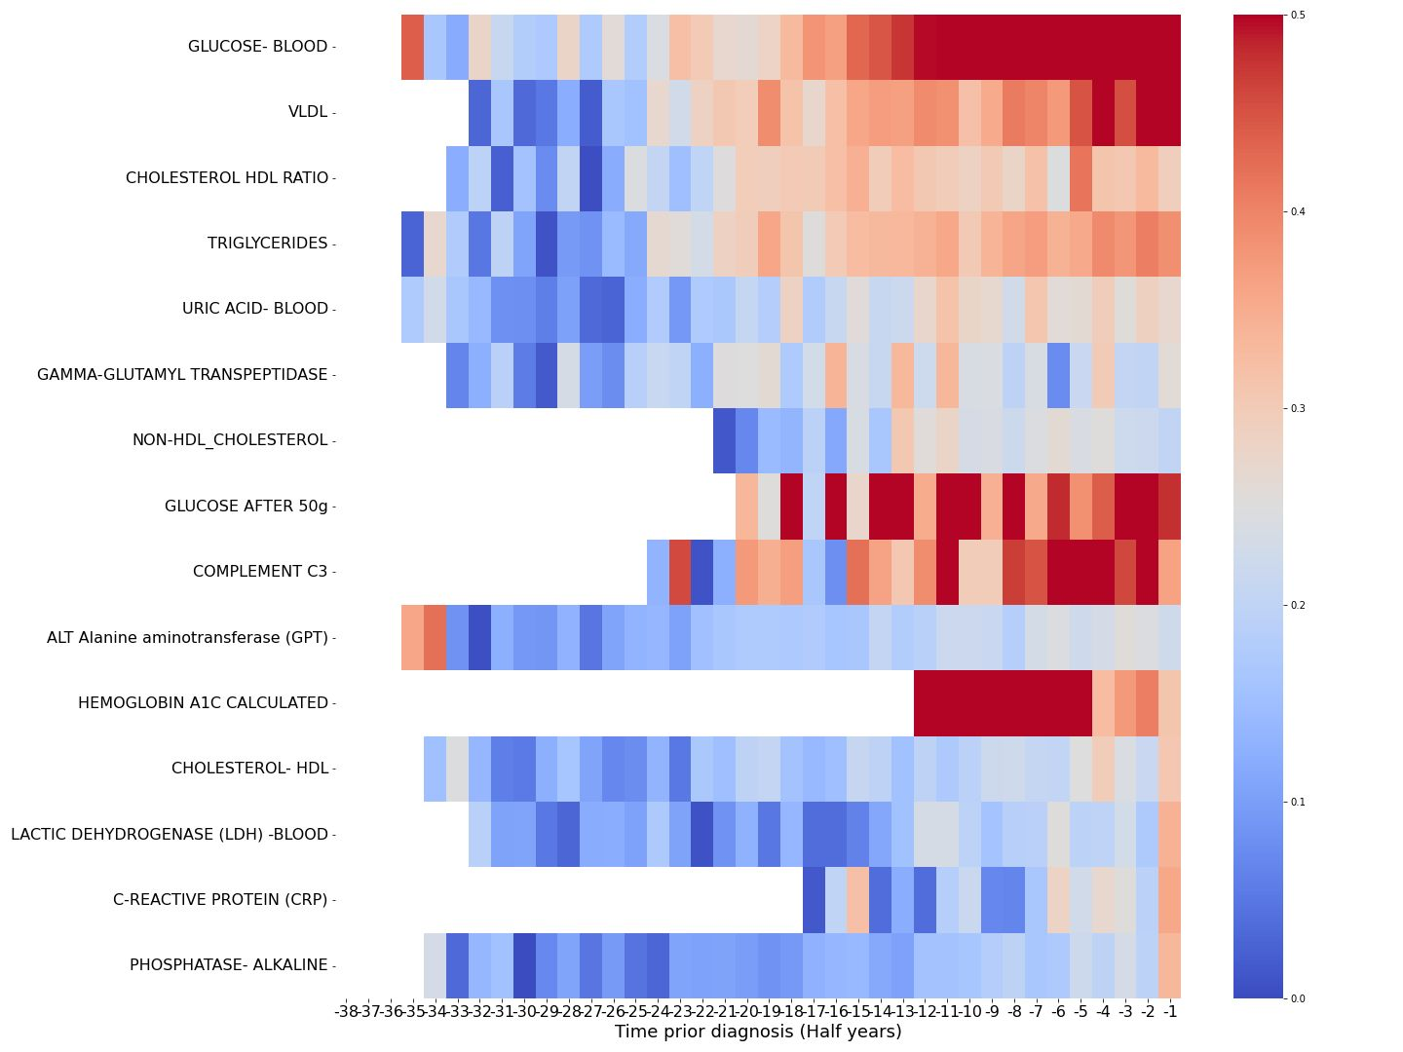
Cohen’s d – Heatmap
Figure 6: Cohen's d over time prior diagnosis (in half years) for the chosen laboratory test
Notes:
במפת החום הכנסנו רק את בדיקות המעבדה שהיה להן לפחות פעם אחת גודל אפקט בינוני ומעלה.
הצבעים זה גודל האפקט, ככחול שיותר כחול זה אפס (אין הבדל בין הקבוצות), ככל שיותר אדום זה הבדלים גדולים יותר בין הקבוצות.
ככל שהגוון נוטה יותר לכיוון צבע האדום ניתן לומר כי גודל האפקט גדול יותר, כלומר מעניין יותר והבדלים גדולים יותר בין הקבוצות.
בציר ה-X ניתן לראות את חצאי השנים אחורה.
למשל, ניתן לראות בשורה 3 עבור הגלוקוז כי 7 שנים לפני האבחון גודל האפקט מאוד גדול בין הקבוצות ואם מתרחקים אחורה עדיין יש הבדלים יחסית יפים.
דוגמה נוספת היא A1C שניתן לראות מ13- נראה גודל אפקט די משמעותי.
מבחינת השומנים כולסטרול HDL RATIO וגם VLDL נראים הכי משמעותיים והרבה יותר חזקים. ייתכן כי לא נרצה להכניס את כל פרופיל השומנים אלא לבחור בשתי בדיקות מובילות אלו לייצוג פרופיל השומנים.
גלוקוז לאחר 50 גרם ידועה כבדיקה לנשים בהריון, ישנה שכיחות גבוהה אצל נשים בהריון שיש להם סוכרת בהריון לפתח סוכרת/טרום סוכרת (בעז). כדאי לבדוק האם ישנו שיבוש שנגרם כתוצאה מהריון, מתחיל בהריון סיכון גבוה יותר ללקות בקדם סכרת (בעז).

Slide 49
Cohen’s d – Heatmap
As can be seen, the highest effect size appears for the differences between the prediabetes group and the control in the results of the glucose test. This effect size began to increase 10 years (20 half years) before the reference date and reached a value above 0.5 as early as 6 years before the diagnosis. This is consistent with the literature, which suggests that glucose is one of the key factors in the diagnosis of prediabetes, but here we find it diagnostic already 6 years before the formal definition of prediabetes.
In addition, as expected, A1C reached high effect sizes 6 years prior to the reference date once there was enough data to perform the test. However, the effect size began to decrease 2.5 years before the diagnosis, possibly due to a lack of data for this test.
The effect sizes of Complement C3 and glucose after 50g are very high although not always consistently. However, it is possible that this inconsistency is also due to lack of data in these relatively rare tests.
In addition, VLDL shows a gradual increase as the reference/diagnosis dates approach, with its effect size already surpassing 0.5 two years before the diagnosis.
Triglycerides and Cholesterol HDL ratio also show relatively high values.
As per the information provided in the previous Section, these findings are in alignment with the literature.

Slide 50
Feature Selection Results
We recommend to define n=500.
The most significant lab tests: Glucose, VLDL, Triglycerides, Gamma GGT, Cholesterol HDL Ratio, Uric Acid, C3, Non HDL Cholesterol, Glucose after 50g, HBA1C, ALT, Cholesterol HDL, LDH, Phosphate Alkaline, CRP.
These 15 lab tests are the selected features.
Notes:
התוצאות מתכתבות עם מפת החום שמתקבלת לפי Cohen’s D
ההבדלים שאנו רואים כאן כמובהקים מתבטאים גם בגודל האפקט כפי שהוא מיוצג במפת חום לפי Cohen’s D

Slide 51
Plots for Selected Lab Tests over Time
The following figures demonstrate the differences between the prediabetes and controls groups over the selected 15 laboratory tests and BMI. These graphs present a comparative trajectory of the laboratory tests over time, leading up to the diagnosis date. The X-axis represents the time dimension, years prior to the diagnosis date, spanning from -12 to 0 years. The Y-axis shows the tests with their measurement units. The prediabetes group is represented by the red line and the control group by the blue line. The shaded line represents the actual group mean value for a laboratory test at a specific time, while the bold line represents a moving average over the lats 1.5 years. The shaded regions around these lines represent confidence interval (α=0.05). The numbers on the lines represent the number of patients added to the group’s meaning in the specific time point. The laboratory and BMI tests that were not too missing are shown, whereas the results for the rest of the tests appear in the appendices.

Slide 52
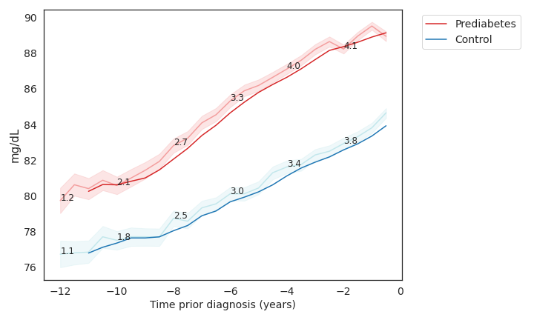
Plot 1: Glucose over time for prediabetes and control
Notes:
כל בדיקת מעבדה בנפרד
הגרף העליון מראה עבור כל האוכלוסייה – בקרות בכחול, חולים באדום
המספרים הקטנים שרשומים הם כמה מטופלים תרמו לחצי שנה באלפים
הגרפים מראים 10 שנים אחורה, כשמרחיבים להסתכל על תקופות יותר רחוקות הם רועשים יותר ולכן נבחר הטווח הזה עד 10-

Slide 53
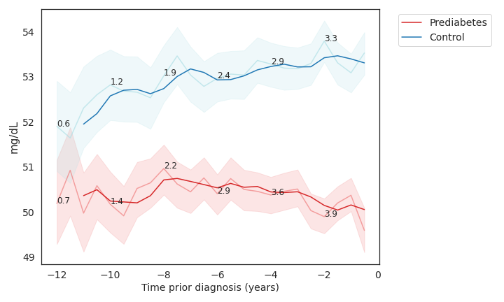
Plot 2: HDL over time for prediabetes and control
Notes:
הגרף מתהפך מכיוון שמדובר בכולסטרול טוב – לבריאים יש יותר

Slide 54
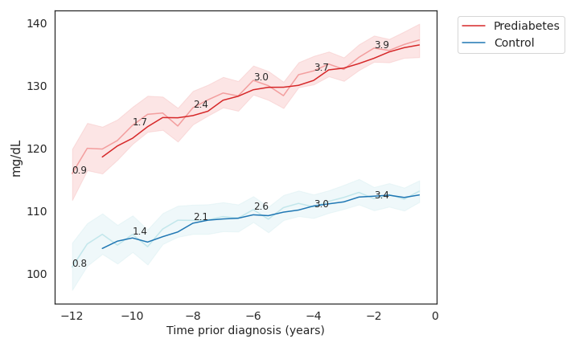
Plot 3: Triglycerides over time for prediabetes and control

Slide 55
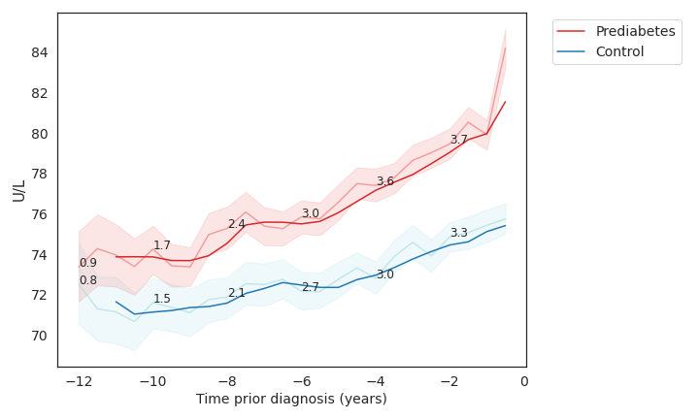
Plot 4: Phosphatase over time for prediabetes and control

Slide 56
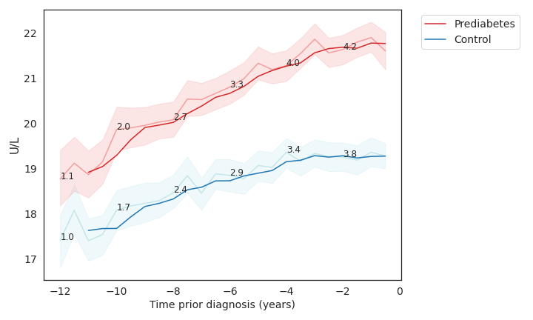
Plot 5: ALT (GPT) over time for prediabetes and control

Slide 57
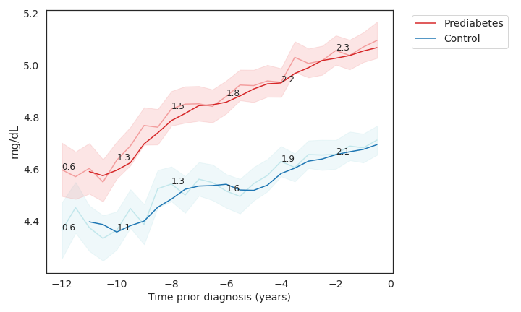
Plot 6: Uric Acid over time for prediabetes and control

Slide 58
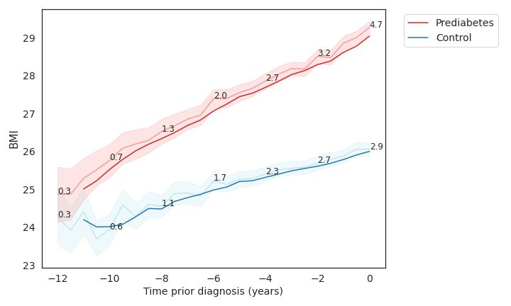
Plot 7: BMI over time for prediabetes and control

Slide 59
Lab tests with high rate of missing values
Graphs fitting the differences between patients who will be prediabetes and controls, over time depicting the progression for laboratory tests that did not pass the threshold (60%) for entry into the CDDRL algorithm due to many missing values.
The tests that didn’t pass : A1C, Glucose after 50g, C3, CRP, GGT, LDH, Non-HDL, HDL-Ratio, VLDL

Slide 60
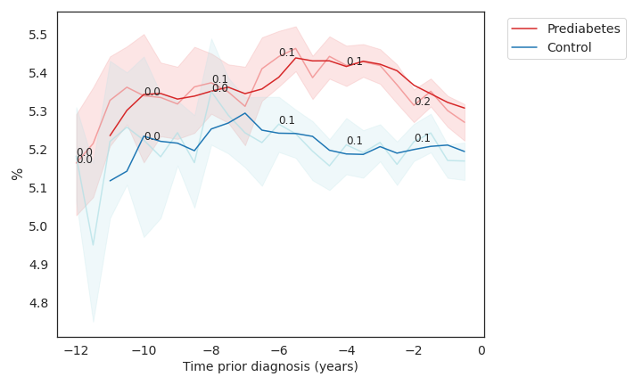
Plot 8: A1C over time for prediabetes and control

Slide 61
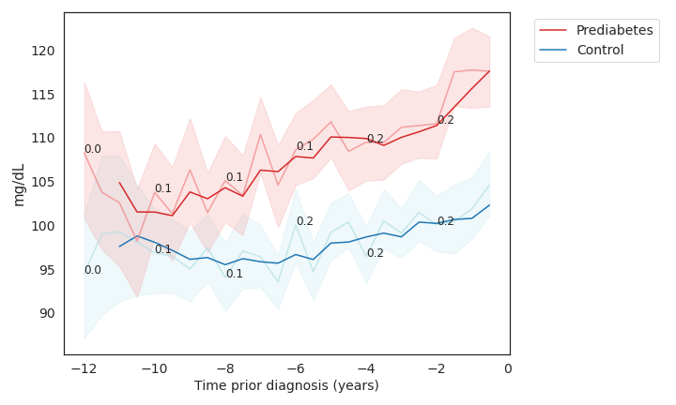
Plot 9: Glucose after 50g over time for prediabetes and control

Slide 62
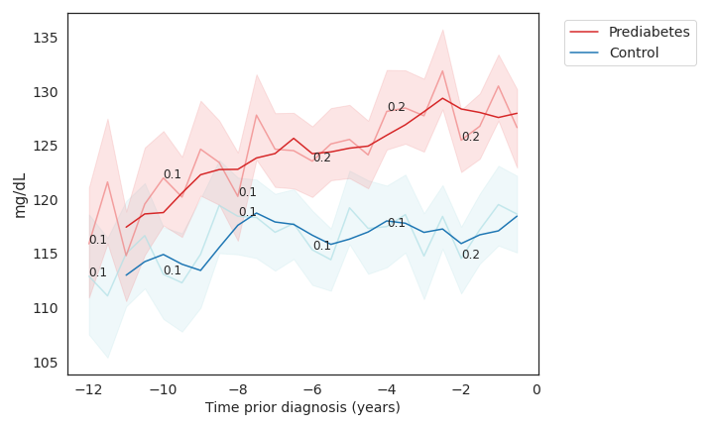
Plot 10: C3 over time for prediabetes and control
Notes:
C3
אחד מחלבוני מערכת המשלים - מערכת שמסייעת למנגנוני החיסון להילחם בפולשים זרים
ערכים נמוכים מהנורמה יכולים להצביע על:
• חוסר של החלבון מלידה - עלול לגרום למחלות אוטואימונית או לזיהומים חוזרים.
• חוסר של החלבון כתוצאה מזיהומים חוזרים.
• מחלות שונות.
ערכים גבוהים מהנורמה עלולים להצביע על זיהום בגוף.

Slide 63
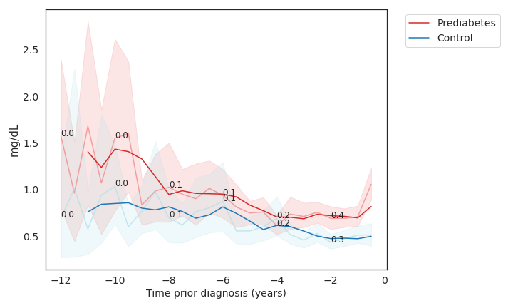
Plot 11: CRP over time for prediabetes and control

Slide 64
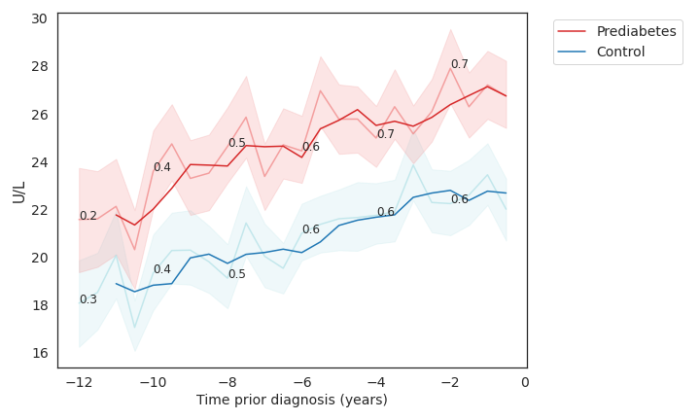
Plot 12: GGT over time for prediabetes and control
Notes:
אנזים שמצוי בעיקר בכבד, בדרכי המרה ובכליות. האנזים מש
ערכים גבוהים מהנורמה עלולים להופיע במצבים הבאים:- מחלות כבד נגיפיות (צהבת נגיפית, מחלת הנשיקה ואחרות).- מחלות כבד שונות - תורשתיות ואוטואימוניות.- כבד שומני.- מחלות בדרכי המרה.- רעלים המצטברים בכבד (למשל, מצריכה מוגברת של אלכוהול).- נטילה של תרופות שונות - במיוחד תרופות אנטי אפילפטיות.לערכים נמוכים מהנורמה אין משמעות רפואית.וחרר לדם כאשר תאים שמכילים אותו נפגעים

Slide 65
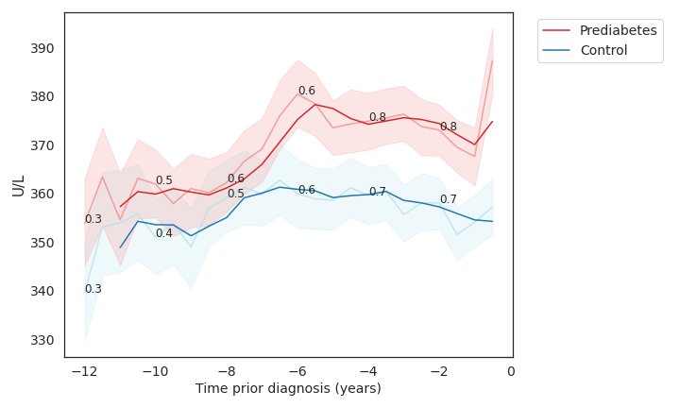
Plot 13: LDH over time for prediabetes and control

Slide 66
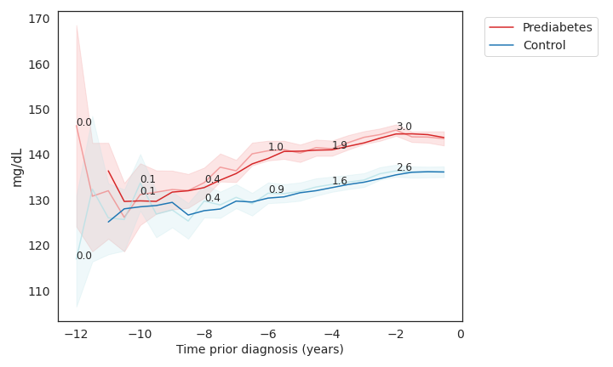
Plot 14: Non-HDL Cholesterol over time for prediabetes and control

Slide 67
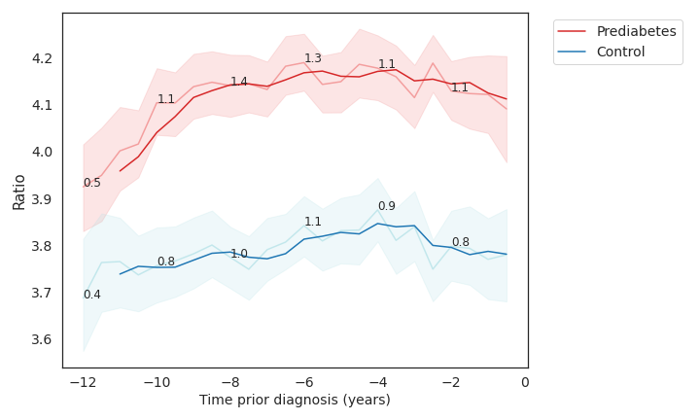
Plot 15: HDL-Ratio Cholesterol over time for prediabetes and control

Slide 68
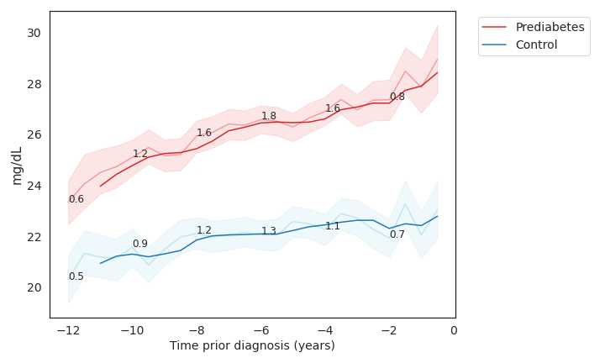
Plot 16: VLDL over time for prediabetes and control
Notes:
נושא טריליצרידים שנוצרו בכבד וכן כולסטרול לרקמות השומן בגוף. יש המתייחסים אליו כאל "כולסטרול רע מאוד" בהיותו גם משמש קודמן של LDL.
רמות גבוהות של VLDL מתפרשות כסיכון מוגבר לפתח טרשת עורקים, מחלות לב ואירועים מוחיים.
רמת VLDL גבוהה יכולה לשקף תת-פעילות של בלוטת התריס (היפותירואידיזם), מצבי סוכרת, ותסמונת נפרוטית.

Slide 69
Selected Features
Description | Lab Test
Glucose | 20100
Uric acid | 20400
Triglycerides | 21300
HDL | 21400
PHOSPHATASE | 21800
ALT-GPT | 22100
Gamma GGT | 22200
LDH | 22300
Hemoglobin HbA1c | 25203
HDL RATIO | 33300
VLDL | 37000
CRP | 60200
C3 | 64700
Non-HDL | 520706
Glucose After 50g | 5201002
Demographic Features
Family History
Sector
Age
BMI
Sector
Notes:
תום

Slide 70
Welch’s t-test with FDR Correction - Summary
The results obtained from applying the Welch t-test on the database of laboratory tests and correcting the p-values by the FDR correction yielded interesting results on the one hand, as laboratory tests known to be a risk factor for the disease showed significance over ten years. On the other hand, we also found years of significant differences for laboratory tests where we did not expect to see big differences between the groups. We hypothesize that these results are caused by the sensitivity of the Welsh test to the sample size.

Slide 71
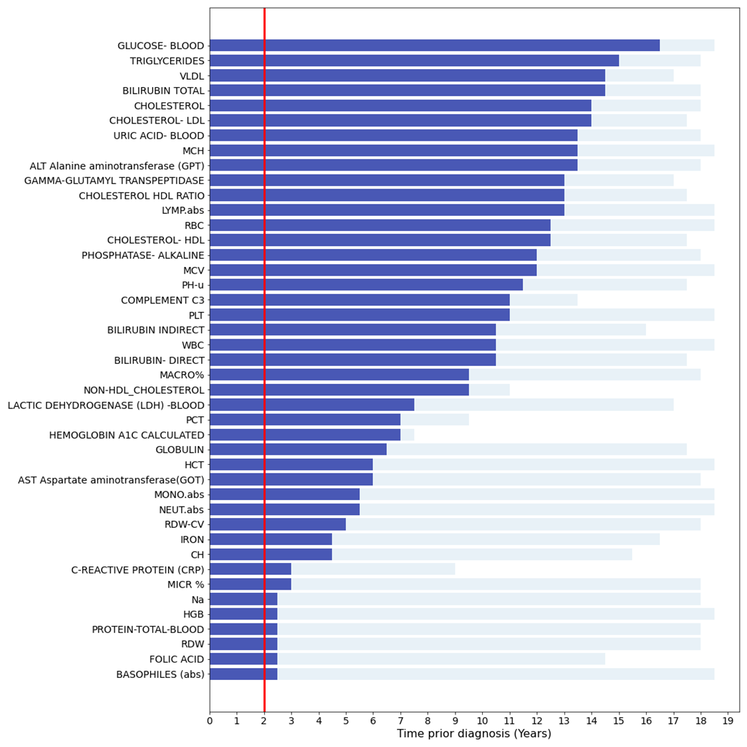
Welch’s t-test with FDR Correction - Summary
Figure 4: Summary of the results of Welch t-tests on the lab tests by time. The Y-axis describes the name of the test. The X-axis stands for the different periods before the diagnosis in which the tests were performed. The blue bars mark the years of significance (adj. p-value<0.05) of a lab test, while the gray bars mark the periods when enough data was obtained to perform the test. The red vertical line marks a predetermined threshold value for a minimum of significant years of two years before diagnosis in order that a test be considered important.
Notes:
במפת החום הכנסנו רק את בדיקות המעבדה שהיה להן לפחות פעם אחת גודל אפקט בינוני ומעלה.
הצבעים זה גודל האפקט, ככחול שיותר כחול זה אפס (אין הבדל בין הקבוצות), ככל שיותר אדום זה הבדלים גדולים יותר בין הקבוצות.
ככל שהגוון נוטה יותר לכיוון צבע האדום ניתן לומר כי גודל האפקט גדול יותר, כלומר מעניין יותר והבדלים גדולים יותר בין הקבוצות.
בציר ה-X ניתן לראות את חצאי השנים אחורה.
למשל, ניתן לראות בשורה 3 עבור הגלוקוז כי 7 שנים לפני האבחון גודל האפקט מאוד גדול בין הקבוצות ואם מתרחקים אחורה עדיין יש הבדלים יחסית יפים.
דוגמה נוספת היא A1C שניתן לראות מ13- נראה גודל אפקט די משמעותי.
מבחינת השומנים כולסטרול HDL RATIO וגם VLDL נראים הכי משמעותיים והרבה יותר חזקים. ייתכן כי לא נרצה להכניס את כל פרופיל השומנים אלא לבחור בשתי בדיקות מובילות אלו לייצוג פרופיל השומנים.
גלוקוז לאחר 50 גרם ידועה כבדיקה לנשים בהריון, ישנה שכיחות גבוהה אצל נשים בהריון שיש להם סוכרת בהריון לפתח סוכרת/טרום סוכרת (בעז). כדאי לבדוק האם ישנו שיבוש שנגרם כתוצאה מהריון, מתחיל בהריון סיכון גבוה יותר ללקות בקדם סכרת (בעז).

Slide 72
Literature Motivation for Selected Features
Of these 15 tests, familiar markers such as blood glucose, HbA1c, lipid profile, uric acid, and ALT-GPT were present.
Interestingly, we also identified markers like gamma GT, LDH, CRP, C3, and alkaline phosphatase, not typically associated with prediabetes or diabetes in the current literature.
Subsequent analysis revealed large effect sizes over extended periods for most of these markers, verifying their relevance.

Slide 73
Data Preparation
Notes:
תום

Slide 74
Time Window Based Approach
The proposed time-window-based approach involves analyzing patient data within a specific time period prior to the diagnosis of prediabetes. This allows the identification of early warning signs and the development of personalized interventions. The division into time windows was made as follows: for each time window in the range between 0-10 years before the diagnosis date (0 means a day before the diagnosis date), we will cut the data so that it contains all the patient data (from "minus infinity", means a time point infinitely far in the past, preceding all other timestamps) up to the start of the window we are examining. For example, for prediction two years before the formal diagnosis, we will use all patient data up to two years before diagnosis. In this way, we predict prediabetes for a patient without using the data collected for them after the prediction time.

Slide 75
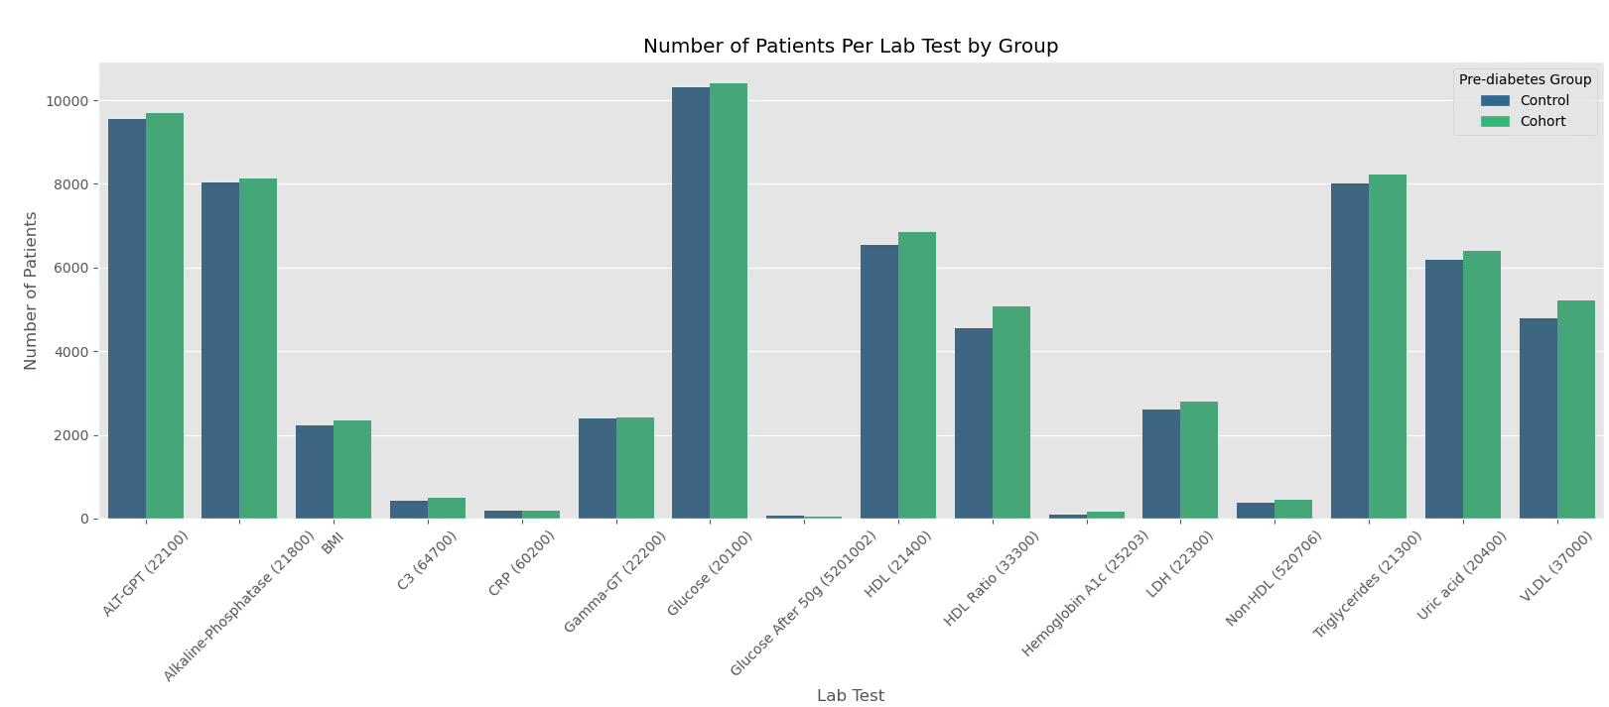
Number of Patients per Lab Test (Original)

Slide 76
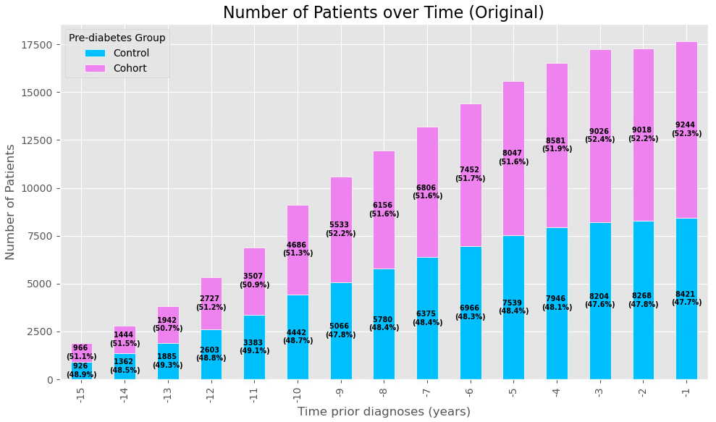
Number of Patients over Time

Slide 77
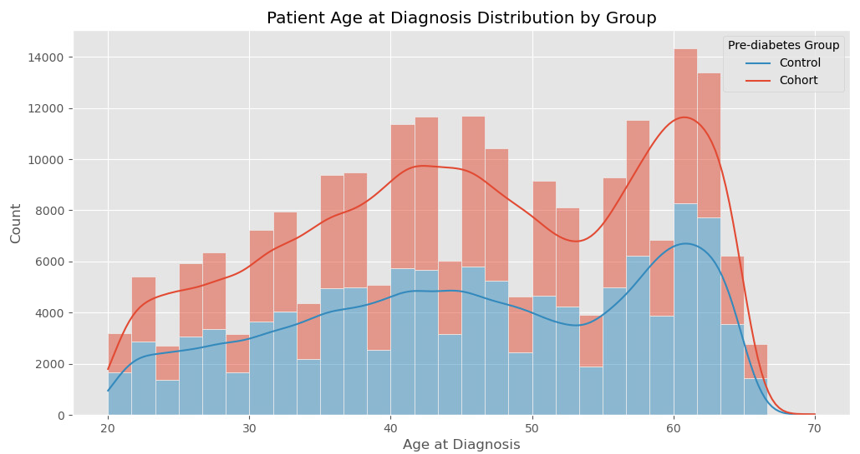
Age at Diagnosis Distribution by Group (Number of Patients?)

Slide 78
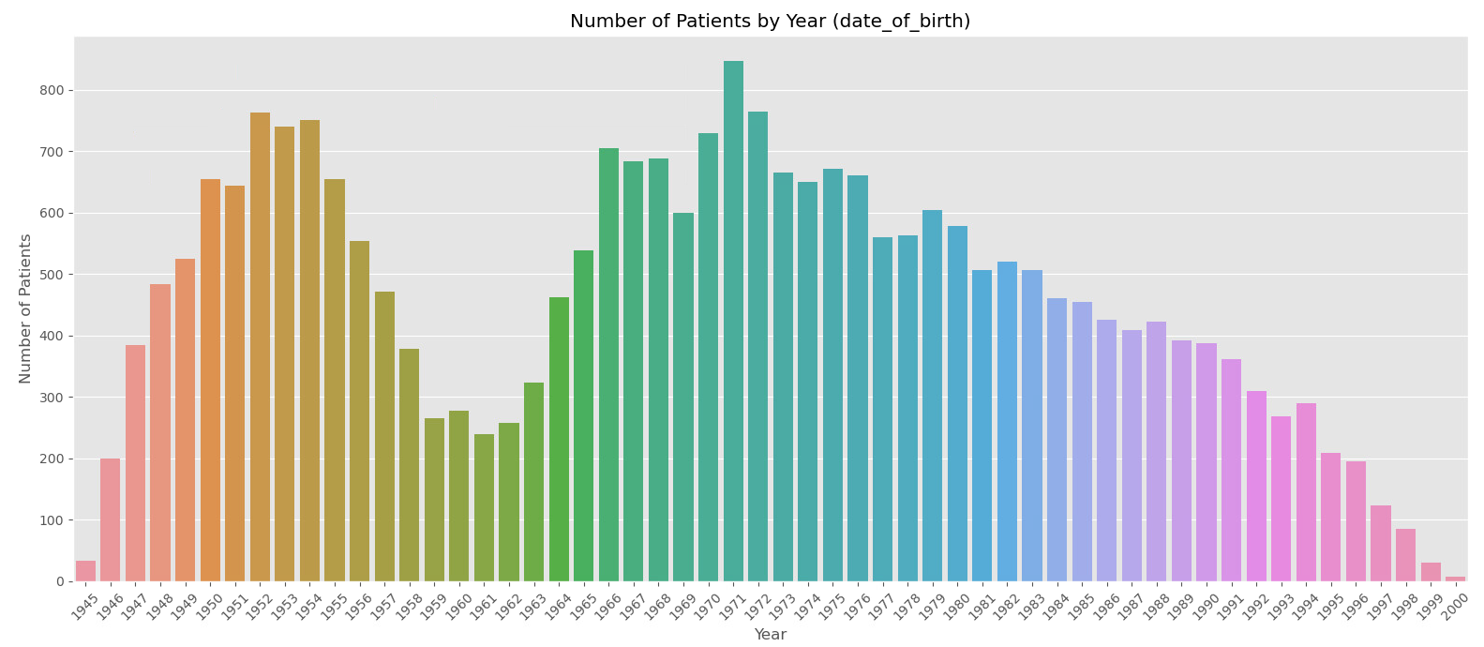
Number of Patients by Year of Birth -> Age

Slide 79
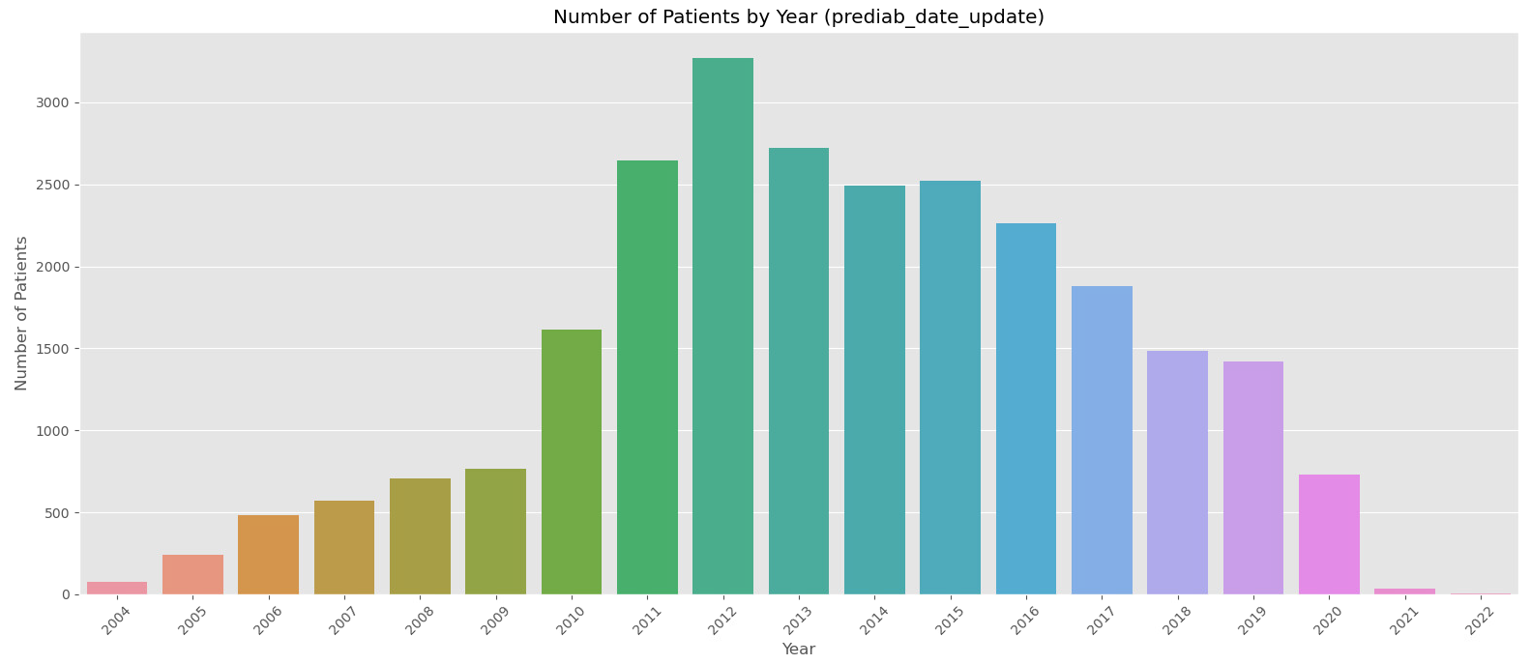
Number of Patients by Year of Diagnosis -> Age At Diagnosis

Slide 80
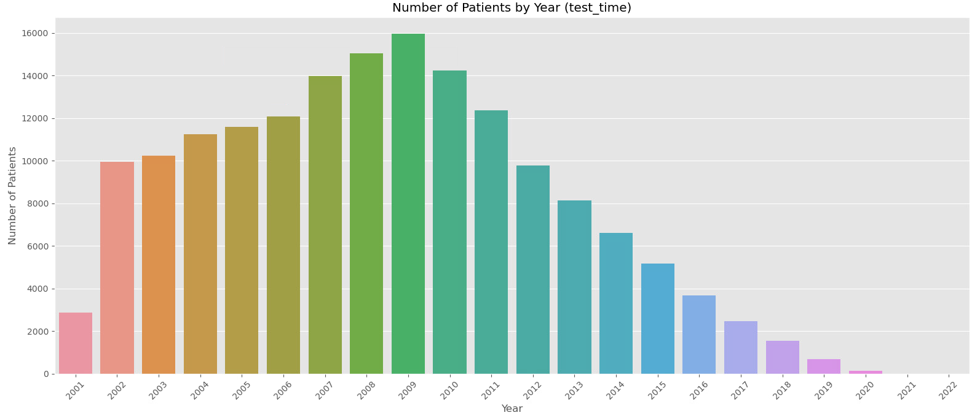
Number of Patients by Year

Slide 81
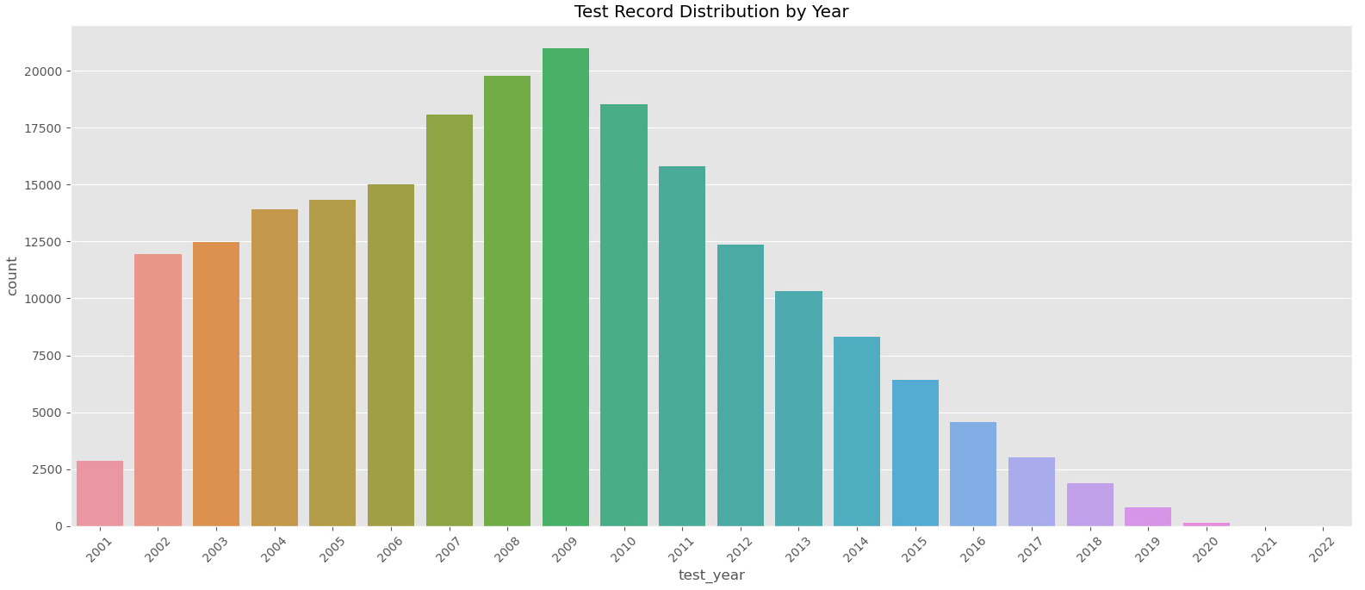
Test Record Distribution by Year

Slide 82
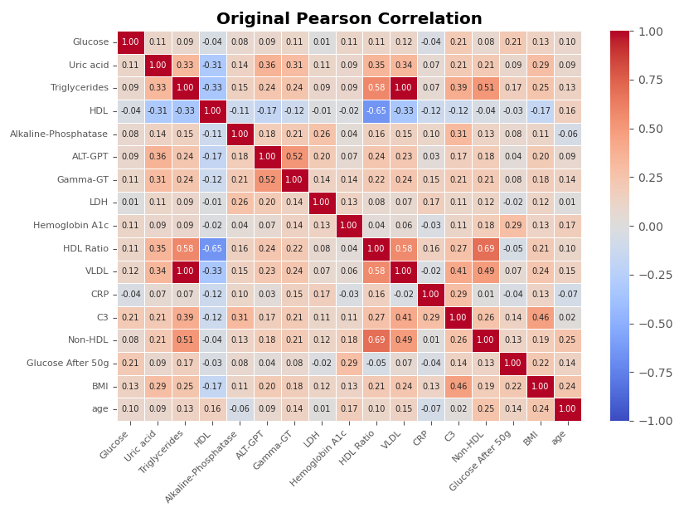
Pearson Correlation
Notes:
לבדוק לפי חלונות זמן

Slide 83
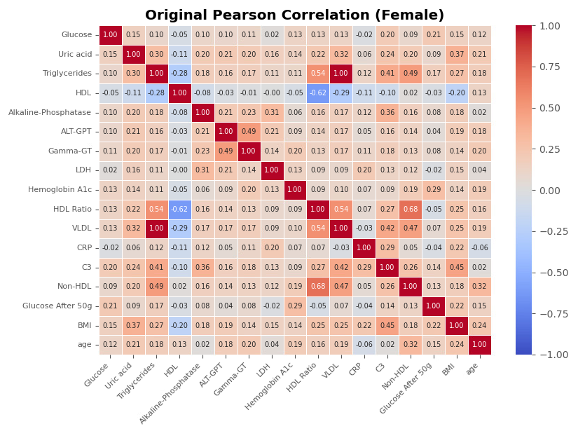
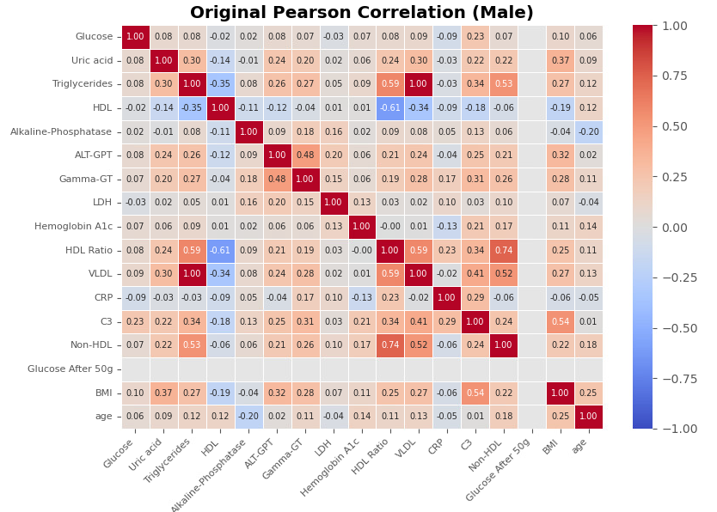
Pearson Correlation by Gender

Slide 84
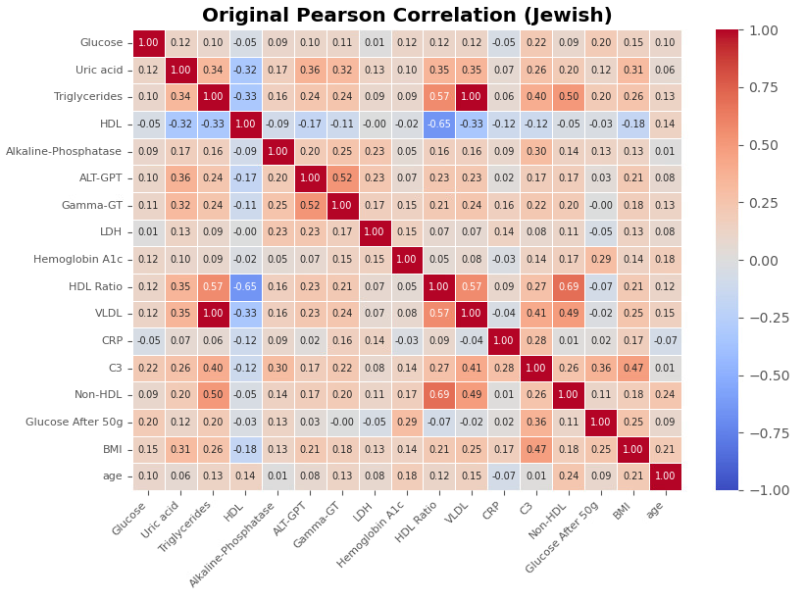
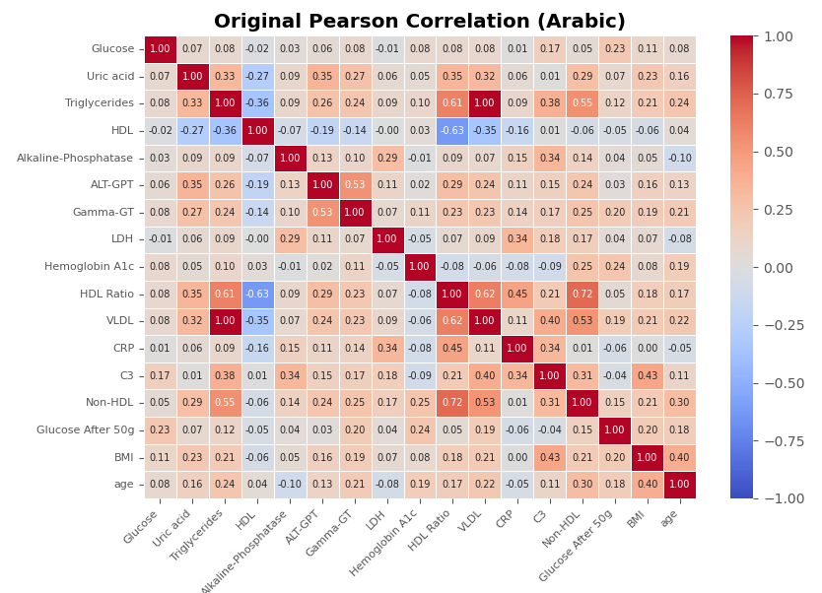
Pearson Correlation by Sector

Slide 85
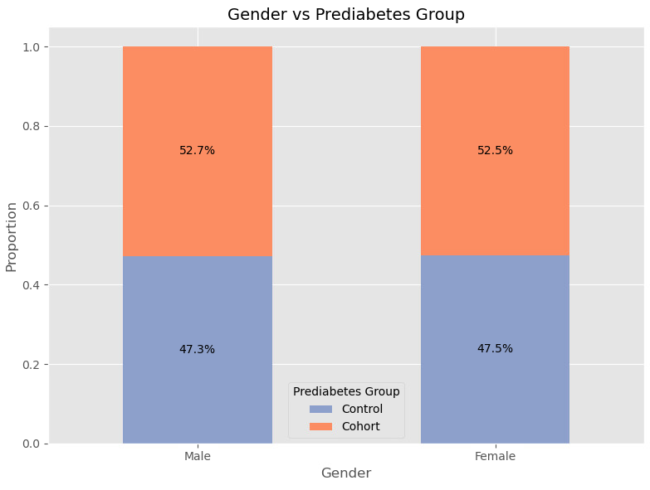

External Validity

Slide 86
Original KS by Group per Year
ALT GPT [-19, -1]: from -13 years back there is a significant difference between Control and Cohort.
Alkaline Phosphate [-19, -1]: from -12 years back there is a significant difference between Control and Cohort.
BMI [-17, -1]: from -13 years back there is a significant difference between Control and Cohort.
C3 [-17, -1]: from -10 years back (also -16) there is a significant difference between Control and Cohort.
CRP [-15, -1]: from -5 years back (also -10, -8, -7) there is a significant difference between Control and Cohort.
GGT [-18, -1]: from -14 years back there is a significant difference between Control and Cohort.
Glucose [-19, -1]: from -16 years back (also -18) there is a significant difference between Control and Cohort.
Glucose after 50g [-14, -1]: from -8 years back there is a significant difference between Control and Cohort.
HDL [-18, -1]: from -12 years back there is a significant difference between Control and Cohort.
HDL Ratio [-18, -1]: from -13 years back there is a significant difference between Control and Cohort.
Hemoglobin A1C [-14, -1]: from -6 years back (also -13, -10, -9) there is a significant difference between Control and Cohort.
LDH [-18, -1]: from -7 years back (also -13, -12, -10, -9) there is a significant difference between Control and Cohort.
Non-HDL [-12, -1]: from -8 years back there is a significant difference between Control and Cohort.
Triglycerides [-19, -1]: from -13 years back (also -17, -16) there is a significant difference between Control and Cohort.
Uric Acid [-19, -1]: from -12 years back there is a significant difference between Control and Cohort.
VLDL [-18, -1]: from -13 years back there is a significant difference between Control and Cohort.

Slide 87
Missing Values
The dataset contains the data of the entire study group, prediabetics and controls, over their entire documented medical history. As shown in Table 2, each patient is represented by several rows, 36 a row for each half year in which they were tested in a laboratory test(s). Many missing values exist because most patients are not screened for all tests each time a laboratory test is performed. Demographic characteristics such as age, gender, sector and smoking data were added to the time-based database (Gilboa, 2024).
Addressing missing data is a critical component of medical data analysis. Accurate and robust imputation techniques are essential for preserving the integrity of medical datasets and ensuring meaningful insights. We adopted a three-step approach for missing values imputation, with a particular emphasis on patient-centric imputation. This approach deliberately avoids the use of extreme values, given the nature of the data, which comprises laboratory test results and BMI (Finegold, 2024).

Slide 88
Missing Values
Examining Missing Values: In our dataset, missing values are encoded as zeros. We observed that data on insulin levels, skin thickness, and pregnancy history are frequently missing, which raises a significant concern: these measurements may have been recorded primarily for individuals with diabetes, while those without the disease were less likely to have them measured. This imbalance could introduce bias into the model, as it may learn patterns based only on diagnosed cases rather than the broader population. To investigate, we analyzed the correlation between these parameters and diagnostic outcomes (healthy/diabetic). A strong correlation would suggest non random missing data due to selective measurement. However, as shown in the table, the analysis revealed no significant correlation. This indicates that the missing data are not health-dependent and do not result from selective measurement. Consequently, standard data imputation techniques can be applied without introducing significant bias into the model.

Slide 89

Missing Records

Slide 90

Missing Patients

Slide 91
Missing Values – Step 1
Step 1: Linear Interpolation over Time for Each Patient Separately
To begin with, we use linear interpolation on each patient's data separately. This approach considers the temporal relationship between data points of the same patient and fills in the missing values by estimating intermediate values based on the available data. The interpolation is performed only between two existing laboratory test results, thus ensuring that the imputed values fall within the range of the patient's data and that the existing trend in the data is not altered.

Slide 92
Missing Values – Step 2
Step 2: Extrapolation using Backward and Forward Filling for Each Patient Separately
After completing the values ​​between existing tests, the second step involves completing missing values ​​for each lab test at time points before its first value and after its last value, for patients who performed the test sometime during the data period. The values ​​were completed with the closest value; By using backward filling (BFill) and forward filling (FFill) techniques, we prevent the use of extreme values that may result from extrapolation using linear or other growth methods. This approach maintains data consistency and avoids the introduction of outliers.
Notes:
השלמת ערכים חסרים אחורה עד למועד של ביצוע בדיקת מעבדה כלשהי שהיא הרשומה הראשונה שתועדה עבור

Slide 93
Missing Values – Step 3
Step 3: Impute Using the Mean over Patients within the same profile group
At this stage, only laboratory tests that the patient has not previously undergone during the entire data period are taken into consideration. First phase of this method is to identify group of patients with the same profile with addressing the following features: Group (Cohort/Control), Gender (Female/Male), Sector (Jewish/Arabic), Age (within 5 years gap) and BMI (using WHO classification of BMI levels). If the profile group is empty then we search a group that meets only the requirements of Group, Age and BMI. If the profile group is still empty then we impute the mean of the Group. Then , we perform the second stage where we iterate through the different laboratory tests while observing the patients with no record of that specific test and impute the missing values based on the mean value of the corresponding laboratory test over time using the data of complete patients within the same profile group as each missing patient.

Slide 94

BMI Classification by WHO
According to the WHO BMI classification,⁷ underweight was <18.5 kg/m², normal weight was 18.5 to <25 kg/m², overweight was 25 to <30 kg/m², and obesity was ≥30 kg/m² .
We have also classified based on the sub obesity groups: Obese classes 1 and 2 was 30 to <40 kg/m² ‘and Obese class 3 ≥40 kg/m².
World Health Organization. WHO Technical Report Series 894. Obesity: preventing and managing the global epidemic. Report of a WHO consultation. 2023 Accessed February 28, 2023. https://apps.who.int/iris/handle/10665/42330Google Scholar

Slide 95
Feature Representation to Fill Missing Values
To enhance interpretability, we decided to categorize the following continues features:
 | Categorization |  |  |  | Variable
Obesity Class 3 (≥40 kg/m2) | Obesity Class 1+2 (30 to <40 kg/m2 ) | Overweight (25 to <30 kg/m2) | Normal Weight (18.5 to <25 kg/m2) | Underweight (<18.5 kg/m2) | BMI
60-65 | 50-60 | 40-50 | 30-40 | 20-30 | Age
Notes:
BMI
מספר המטופלים שערכי BMI שלהם מסווגים מחלקה 3 של השמנה (מעל 40): 1,754 מטופלים.
מספר המטופלים ללא ערכי BMI: 1,840 מטופלים.
Age
חלוקה ל-bins של גילאים.

Slide 96


BMI Outliers Removal

Slide 97
Smoking Missing Values
Smoking is the final feature we needed to fill missing data. We chose to perform imputation with the earlier value between two different values, that means if the patient did not smoke in -5 and smoked in -2 then we presume the patient did not smoke until we documented otherwise. For missing values before the first documentation and after the last, we used bfill and ffill correspondingly.

Slide 98



Smoking - Before and After Missing Values
Before
After
Notes:
כלל המשתנים הקטגוריאליים שלנו הם משתנים דמוגרפיים בינאריים ולכן בחרנו להציג את ההרכב של כל אחד מהם באמצעות תרשימי עוגה.
ניתן לראות מתרשים העוגה של משתנה המטרה כי אכן קיים איזון מוחלט בין החולים לבקרה כמצופה.
ההרכבים הנוספים שנצפו במדגם שלנו הם מגדר (62.1% נשים), מגזר (76.3% יהודים), האם המטופל עישן בעבר (75.4% לא מעשנים), היסטוריה משפחתית (96.6% ללא רקע).
הסיבות לחוסר איזון זה במגדר המטופלים שהתקבלה במדגם שלנו הן ראשית חוסר האיזון בנתונים הגולמיים בהם יש רוב נשים ובנוסף העובדה כי יותר נשים עמדו בתנאים שהוגדרו לכניסה למדגם המזווג במחקרם של פיינגולד וגלבוע (2023). כיוצא בכך מרבית המטופלים במדגם שלנו הם נשים.

Slide 99
Original vs Imputed KS by Group per Year
ALT GPT [-19, -1]: same distribution for Control and Cohort over all years.
The rest have some years with different distributions for Control and Cohort.

Slide 100
Important Articles to read
https://pmc.ncbi.nlm.nih.gov/articles/PMC10762598/#sec10
https://www.google.com/search?q=youngest+prediabetes+patient&oq=youngest+prediabetes+patient&gs_lcrp=EgZjaHJvbWUyBggAEEUYOTIHCAEQIRigAdIBCTEwODk5ajBqN6gCALACAA&sourceid=chrome&ie=UTF-8
https://pubmed.ncbi.nlm.nih.gov/31790544/
https://www.yalemedicine.org/news/prediabetes
https://jamanetwork.com/journals/jama/article-abstract/2759484#google_vignette
https://www.akronchildrens.org/inside/2022/04/14/prediabetes-in-kids/
https://www.publichealth.columbia.edu/news/youth-prediabetes-linked-likelihood-poor-pregnancy-outcomes
https://archive.cdc.gov/www_cdc_gov/media/releases/2019/p1202-diabetes.html

Slide 101
Summary
Our data preprocessing phase involved outlier removal using Tukey fences, and subsequently, we embarked on the feature selection stage to pinpoint which lab tests would be important in predicting prediabetes. By leveraging the Welch's t-test and incorporating a bootstrapping method, we managed to filter out irrelevant lab tests due to the large sample size's influence and landed on a subset of 15 lab tests and BMI.
Of these 15 tests, familiar markers such as blood glucose, HbA1c, lipid profile, uric acid, and ALT-GPT were present. Interestingly, we also identified markers like gamma GT, LDH, CRP, C3, and alkaline phosphatase, not typically associated with prediabetes or diabetes in the current literature. Subsequent analysis revealed large effect sizes over extended periods for most of these markers, verifying their relevance.

Slide 102
Lab Test Results Comparison – Before and After handling missing values
Notes:
גיל
להתייחס לעובדה כי בהינתן 2,989 בדיקות מעבדה לא ניתן להבין יותר מדי מהנתונים
כמו כן, השתמשנו במדגם לאחר השלמת ערכים חסרים של מורז

Slide 103

Glucose Comparison
Before
After

Slide 104


Glucose Distribution Comparison
Before
After

Slide 105

HDL Comparison
Before
After

Slide 106


HDL Distribution Comparison
Before
After

Slide 107

Triglycerides Comparison
Before
After

Slide 108


Triglycerides Distribution Comparison
Before
After

Slide 109

Alkaline Phosphatase Comparison
Before
After

Slide 110


Alkaline Phosphatase Distribution Comparison
Before
After

Slide 111

ALT GPT Comparison
Before
After

Slide 112


ALT GPT Distribution Comparison
Before
After

Slide 113

Uric Acid Comparison
Before
After

Slide 114


Uric Acid Distribution Comparison
Before
After

Slide 115

BMI Comparison
Before
After

Slide 116


BMI Distribution Comparison
Before
After

Slide 117
Lab tests with high rate of missing values
Graphs fitting the differences between patients who will be prediabetes and controls, over time depicting the progression for laboratory tests that did not pass the threshold (60%) for entry into the CDDRL algorithm due to many missing values.
The tests that didn’t pass : A1C, Glucose after 50g, C3, CRP, GGT, LDH, Non-HDL, HDL-Ratio, VLDL
Notes:
לאחר השלמת ערכים חסרים ההיסטוגרמה של משתנים אלה מאוד התעוותה, יש לשים לב כי מדובר באחוז גבוה מאוד של ערכים חסרים!!!

Slide 118

Hemoglobin A1c Comparison
Before
After

Slide 119


Hemoglobin A1c Distribution Comparison
Before
After

Slide 120

Glucose after 50g Comparison
Before
After

Slide 121


Glucose after 50g Distribution Comparison
Before
After

Slide 122

C3 Comparison
Before
After

Slide 123


C3 Distribution Comparison
Before
After

Slide 124

CRP Comparison
Before
After

Slide 125


CRP Distribution Comparison
Before
After

Slide 126

Gamma-GT (GGT) Comparison
Before
After

Slide 127


Gamma-GT (GGT) Distribution Comparison
Before
After

Slide 128

LDH Comparison
Before
After

Slide 129


LDH Distribution Comparison
Before
After

Slide 130

Non-HDL Comparison
Before
After

Slide 131


Non-HDL Distribution Comparison
Before
After

Slide 132

HDL Ratio Comparison
Before
After

Slide 133


HDL Ratio Distribution Comparison
Before
After

Slide 134

VLDL Comparison
Before
After

Slide 135


VLDL Distribution Comparison
Before
After

Slide 136
Data Understanding After Feature Selection
Notes:
גיל
להתייחס לעובדה כי בהינתן 2,989 בדיקות מעבדה לא ניתן להבין יותר מדי מהנתונים
כמו כן, השתמשנו במדגם לאחר השלמת ערכים חסרים של מורז

Slide 137

Number of Patients over years

Slide 138



Relationship between Binary Explanatory Features

Slide 139
Relationship between Binary and Continues Explanatory Features

Slide 140
Statistical Tests
Shapiro-Wilk: Normality distribution test.
KS Test: Utilized for Comparing Distributions (before and after filling missing values) and Discriminability in binary classification by Group per Year.
Feature Correlation tests: Pearson , chi square, Point biserial (numeric & binary).
Multicollinearity: VIF score

Slide 141
Kolmogorov-Smirnov (KS) Test for Missing Data
After training the model to minimize the loss of the autoencoder, it is necessary to check whether the feature vectors of the generated output layer represent the feature vector of the original dataset well. The first evaluation method uses the Kolmogorov-Smirnov test (KStest) based on the probability distribution. This verifies the possibility that different samples were extracted from the same distribution. The cosine similarity or Euclidean distance can be used to check the vector similarities, but in this study, KStest is used to check whether the augmented dataset fits the original dataset’s distribution. The augmented vector from the first data augmentation process is compared with each feature group’s original vector distribution, and only samples verified with a p-value of under 0.05 are moved to the next step.
https://ieeexplore.ieee.org/abstract/document/10517591
In the scenario of longitudinal datasets, the classifier should capture differences across the time dimension as well. An appropriate classifier which can handle mixed-length sequences of mixed data types, is an RNN classifier. This is the classifier we use to analyze classifier predictions and perform the KS test to test. https://link.springer.com/article/10.1186/s12874-024-02304-4
A XGBoost algorithm was used to select the important features and construct a diagnostic model. The receiver operating characteristic (ROC) curve, Kolmogorov-Smirnov (KS) curve, accuracy, sensitivity, specificity, positive predictive value (PPV), and negative predictive value (NPV) were used to measure the performance of the model. https://papers.ssrn.com/sol3/papers.cfm?abstract_id=4033433

Slide 142
Kolmogorov-Smirnov (KS) Test for Missing Data
Another commonly used test is the Kolmogorov–Smirnov K-S test, which simply tests that two samples came from the same distribution [123]. The test is based on a well-known statistical metric, which is calculated by finding the maximum absolute value of the differences in the cumulative distribution functions of the two compared samples as seen in Reference [10]
[123] https://www.tandfonline.com/doi/abs/10.1080/01621459.1951.10500769 Massey Jr, F. J. (1951). The Kolmogorov-Smirnov test for goodness of fit. Journal of the American statistical Association, 46(253), 68-78.‏
[10] https://academic.oup.com/jamia/article-abstract/26/3/228/5235390
Baowaly, M. K., Lin, C. C., Liu, C. L., & Chen, K. T. (2019). Synthesizing electronic health records using improved generative adversarial networks. Journal of the American Medical Informatics Association, 26(3), 228-241.‏
We then analyzed and compared the models’ performance by using a few statistical methods (Kolmogorov–Smirnov test, dimension-wise probability for binary data, and dimension-wise average count for count data) and 2 machine learning tasks (association rule mining and prediction).

Slide 143

Kolmogorov-Smirnov (KS) Test for Feature Selection
The analysis effectively highlights the differences in variable distributions between individuals with positive (Outcome 1) and negative (Outcome 0) diabetes outcomes. Using the Kolmogorov-Smirnov (KS) test, the results consistently demonstrate statistically significant differences (p < 0.05) for all variables, indicates that the null hypothesis, which assumes the distributions of the two groups (Outcome 0 and Outcome 1) are identical, can be rejected. Thus, we conclude that the distributions of the variables differ significantly between the two outcomes. The statistically significant results prove a meaningful association between the tested variables and diabetes outcomes. This insight suggests that these variables have strong potential as predictors for diabetes, reinforcing their relevance in identifying individuals at risk.
The K-S Statistic, or the Kolmogorov-Smirnov statistic can be used as an evaluation metric for a binary classifier. It helps to understand whether two sets of samples belong to similar probability distribution or not, hence measures the degree of separability between two classes in the dataset.

Slide 144
Kolmogorov-Smirnov (KS) Test for Feature Selection

Slide 145
Kolmogorov-Smirnov (KS) Test as Evaluation Metric
Evaluating binary classifiers using KS Statistic
The K-S Statistic, or the Kolmogorov-Smirnov statistic can be used as an evaluation metric for a binary classifier. It helps to understand whether two sets of samples belong to similar probability distribution or not, hence measures the degree of separability between two classes in the dataset.
If the model is not able to distinguish between the positive class and the negative class, the rate of True Positives and True Negatives will be low, and the KS Statistic would be closer to 0. A high KS Statistic is indicative of a model that predicts the classes more accurately.

Slide 146
VIF Results
Feature Selection using Multicollinearity Detection via VIF –
We employed Variance Inflation Factor analysis to identify multicollinearity among features. Using the standard threshold of VIF≥10, we identified that ___ exhibited high multicollinearity, which corresponded with patterns observed in our correlation matrix. Consequently, these features were removed from the dataset.

Slide 147




VIF Results for each Time Window
Notes:
אין בעיית Multicollinearity משמעותית כי כל ערכי VIF שהתקבלו נמוכים מ-5

Slide 148

Pearson Correlation Results for First Time Window

Slide 149

Pearson Correlation Results for Second Time Window

Slide 150

Pearson Correlation Results for Third Time Window

Slide 151

Pearson Correlation Results for Forth Time Window

Slide 152
Feature Selection
Glucose and insulin coloms: We are considering testing a model without the Glucose and Insulin columns, with the goal of developing a model that does not rely on blood tests at all and instead uses only easily measurable indicators. Blood tests for glucose and insulin require fasting and a clinic visit, making them less accessible and more inconvenient. During the evaluation stage, we will compare models with and without these features. If the predictive performance remains similar, we will prefer the model that relies only on easily measurable indicators.

Slide 153


Relationship between Continues Explanatory Features
Notes:
קשר חזק בין המשתנים, סביר שמדובר בתלות משמעותית (0.6-0.79) בין המשתנים HDL Ratio ו-Triglycerides עם מתאם 0.71. קשר בינוני, ייתכן קשר סיבתי או תלות (0.4-0.59) בין המשתנה HDL Ratio לבין המשתנים VLDL, Triglycerides, Non-HDL וגם בין המשתנה Triglycerides לבין המשתנה Non-HDL.

Slide 154
Statistical Tests
In general we can see that the correlation decreases as we get closer to the diagnosis date.
Triglycerides and VLDL have shown the highest correlation through all time windows.
The next pair with the highest correlation is HDL and HDL Ratio.
Both pairs with correlation higher than 0.5.
Also, HDL Ratio and VLDL both have the next highest correlation with each other.
As we have seen earlier, VLDL and HDL Ratio both has many missing values (over 60%) and therefore we chose to remove both from our dataset and keep Triglycerides and HDL.

Slide 155





Binary Features
Notes:
כלל המשתנים הקטגוריאליים שלנו הם משתנים דמוגרפיים בינאריים ולכן בחרנו להציג את ההרכב של כל אחד מהם באמצעות תרשימי עוגה.
ניתן לראות מתרשים העוגה של משתנה המטרה כי אכן קיים איזון מוחלט בין החולים לבקרה כמצופה.
ההרכבים הנוספים שנצפו במדגם שלנו הם מגדר (62.1% נשים), מגזר (76.3% יהודים), האם המטופל עישן בעבר (75.4% לא מעשנים), היסטוריה משפחתית (96.6% ללא רקע).
הסיבות לחוסר איזון זה במגדר המטופלים שהתקבלה במדגם שלנו הן ראשית חוסר האיזון בנתונים הגולמיים בהם יש רוב נשים ובנוסף העובדה כי יותר נשים עמדו בתנאים שהוגדרו לכניסה למדגם המזווג במחקרם של פיינגולד וגלבוע (2023). כיוצא בכך מרבית המטופלים במדגם שלנו הם נשים.

Slide 156

Plot 1: Glucose over time for prediabetes and control
Notes:
כפי שצוין קודם לכן סט הנתונים שלנו הוא טמפורלי ולכן בחרנו להציג את ההתנהגות של המשתנים הרציפים לאורך השנים שלפני מועד האבחון על ידי שימוש בתרשימי מגמות.
המשתנים הרציפים הללו כוללים את בדיקות המעבדה ו-BMI.
בחרנו לבצע סינון של השנים בגרף ולהציג החל מ15 שנים לפני מועד האבחון מכיוון שהנתונים שקודמים לתקופה זו הם דלים ולא אינפורמטיביים.
בנוסף, בחרנו לשלב בגרף עבור קו המגמה של החולים והבקרה הצגה של רווח הסמך לתוחלת שמחושב על ידי הממוצע שהתקבל במדגם באותה שנה בתוספת שלוש סטיות תקן.
המספרים על הגרף מייצגים את כמות התצפיות באותה שנה עבור קבוצות החולים והבקרה.
לפי כלל תרשימי המגמות, ניכר כי ישנה הבחנה ברורה בין קבוצת הניסוי לבקרה בקווי המגמה שמייצגים את השינוי בערכים הממוצעים של בדיקות המעבדה השונות שהולך וגדל לאורך הזמן ככל שמתקרבים למועד האבחון.

Slide 157

Plot 2: HDL over time for prediabetes and control
Notes:
ישנה בדיקת מעבדה אחת בלבד, 21400 (Cholesterol HDL), שעבורה מתקבלים ערכים נמוכים של תוצאת הבדיקה עבור קבוצת החולים במחלה (קבוצת הניסוי) לאורך הזמן. המגמה שהתרשים הנ"ל מציג וההבחנה הברורה בין קבוצת הביקורת לקבוצת הניסוי היא הגיונית לאור העובדה כי כולסטרול HDL המוכר בתור "כולסטרול טוב" נמצא בריכוז נמוך בקרב החולים בטרום סכרת לאורך השנים לפני האבחון לעומת קבוצת הביקורת שעבורה קיים ריכוז גבוה. ערכים נמוכים של כולסטרול זה ידועים לפי הספרות כגורמי סיכון לחלות במחלה.

Slide 158

Plot 3: Triglycerides over time for prediabetes and control

Slide 159

Plot 4: Alkaline Phosphatase (ALP) over time for prediabetes and control
Notes:
זיהינו תופעה מעניינת בתרשים של מדד Alkaline Phosphatase אשר נמצא במגמת ירידה עד 6 שנים לפני מועד האבחון ומנקודה זה ישנה עלייה רציפה עד למועד האבחון הן עבור קבוצת החולים והן עבור קבוצת הבקרה.

Slide 160

Plot 5: ALT (GPT) over time for prediabetes and control

Slide 161

Plot 6: Uric Acid over time for prediabetes and control

Slide 162

Plot 7: BMI over time for prediabetes and control

Slide 163

Plot 8: A1C over time for prediabetes and control

Slide 164

Plot 9: Glucose after 50g over time for prediabetes and control

Slide 165

Plot 10: C3 over time for prediabetes and control
Notes:
C3
אחד מחלבוני מערכת המשלים - מערכת שמסייעת למנגנוני החיסון להילחם בפולשים זרים
ערכים נמוכים מהנורמה יכולים להצביע על:
• חוסר של החלבון מלידה - עלול לגרום למחלות אוטואימונית או לזיהומים חוזרים.
• חוסר של החלבון כתוצאה מזיהומים חוזרים.
• מחלות שונות.
ערכים גבוהים מהנורמה עלולים להצביע על זיהום בגוף.

Slide 166

Plot 11: CRP over time for prediabetes and control

Slide 167

Plot 12: GGT over time for prediabetes and control
Notes:
אנזים שמצוי בעיקר בכבד, בדרכי המרה ובכליות. האנזים מש
ערכים גבוהים מהנורמה עלולים להופיע במצבים הבאים:- מחלות כבד נגיפיות (צהבת נגיפית, מחלת הנשיקה ואחרות).- מחלות כבד שונות - תורשתיות ואוטואימוניות.- כבד שומני.- מחלות בדרכי המרה.- רעלים המצטברים בכבד (למשל, מצריכה מוגברת של אלכוהול).- נטילה של תרופות שונות - במיוחד תרופות אנטי אפילפטיות.לערכים נמוכים מהנורמה אין משמעות רפואית.וחרר לדם כאשר תאים שמכילים אותו נפגעים

Slide 168

Plot 13: LDH over time for prediabetes and control

Slide 169

Plot 14: Non-HDL Cholesterol over time for prediabetes and control

Slide 170

Plot 15: HDL-Ratio Cholesterol over time for prediabetes and control
Notes:
מתפלג נורמלית לפי מבחן שפירו-וילק

Slide 171

Plot 16: VLDL over time for prediabetes and control

Slide 172
Feature Clustering
Feature clustering is an unsupervised learning technique that groups features (rather than observations) into homogeneous clusters based on their similarities. This approach identifies relationships, redundancies, and dependencies among features, which is particularly important for dimensionality reduction, feature selection, and improving model interpretability (ML Techniques, 2023). By clustering features, only the most representative feature from each cluster is retained, preserving critical information while removing redundancy and noise (JSoftware, 2010).
Practical Applications
Bioinformatics (Tibshirani et al., 2002): Correlation-based clustering is extensively used in gene expression data to group genes with similar behavior.
Finance (Gupta et al., 2019): Feature clustering using D=1−∣R∣ helps identify interrelated financial indicators, improving model interpretability.
References:
ML Techniques. (2023). Feature clustering: A simple solution to many machine learning problems. https://mltechniques.com/2023/03/12/feature-clustering-a-simple-solution-to-many-machine-learning-problems/
Dhillon, I. S., et al. (2003). Feature clustering for dimensionality reduction. https://www.jmlr.org/papers/volume3/dhillon03a/dhillon03a.pdf
JSoftware. (2010). Correlation coefficient clustering for feature selection. https://www.jsoftware.us/vol5/jsw0512-9.pdf

Slide 173
Feature Clustering – Supporting Evidence
Similarity Metrics: Feature clustering relies on metrics that quantify dependencies between features.
Common metrics include:
Correlation Coefficients: The absolute value of the correlation coefficient (∣r∣) captures both strong positive and negative relationships between features (ML Techniques, 2023; Dhillon et al., 2003).
Mutual Information (MI): Measures the dependency between two random variables.
Chi-Square Tests: Used for assessing independence between categorical variables.
According to ML Techniques (2023), the use of ∣r∣ ensures a scale-invariant similarity measure, capturing dependencies regardless of feature units.
Clustering Approach: Unlike traditional clustering methods that use Euclidean distances, feature clustering often leverages information-theoretic measures or correlation-based distances. These measures better capture interdependencies between features, which is especially crucial in high-dimensional datasets where redundant features can harm performance (JSoftware, 2010).
Improves Interpretability: Feature clustering aids in understanding variable relationships, providing significant insights in fields like bioinformatics. For example, clustering genes based on similar behavior and dependencies has been instrumental in gene expression studies (ML Techniques, 2023).

Slide 174
Main differences between variable & observation clustering?
Feature clustering differs from feature selection in that it focuses on grouping features based on mutual dependencies, whereas feature selection often evaluates each feature individually. This technique is particularly effective for high-dimensional datasets, where feature redundancy can significantly impact computational efficiency and model performance (Dhillon et al., 2003).
Notes:
אשכול מאפיינים הוא שימושי במיוחד כאשר רוצים לזהות מאפיינים שמתנהגים בצורה דומה ולצמצם מימדים.
כאשר עושים אשכולות למאפיינים במקום לתצפיות, יוצרים מטריצת מרחקים בין מאפיינים, Feature Distance Matrix)) ואז מפעילים אלגוריתם אשכולות.
מטריצת מרחקים מתאימה ב-Feature Clustering כי היא מאפשרת לנו לבדוק דמיון בין משתנים שונים.
Hierarchical Clustering - יציב וטוב, לפעמים טוב יותר ומתאים לרוב סוגי הנתונים
Spectral Clustering - טוב לקשרים לא ליניאריים, לפעמים נותן הפרדה ברורה יותר, טוב כאשר יש קבוצות עם צורה מורכבת

Slide 175
Hierarchical Feature Clustering
1. Calculate Feature Distance metric:
The absolute value of the correlation coefficient (∣𝑟∣) is used as the similarity metric. It focuses only on the strength of relationships, ignoring direction (positive or negative).
Pearson correlation measures linear relationships between features.
Feature clustering using 1−∣𝑟∣ allows for scale-invariant grouping of highly correlated variables, making it effective for datasets with mixed scales (ML Techniques, 2023).
Converts correlation to a distance metric where stronger correlations (closer to ∣r∣=1) translate to smaller distances (D=0). Features with weak or no correlation (R≈0) are assigned larger distances (D=1).
2. Linkage Using Ward’s Method:
Clustering uses Ward's method, which minimizes intra-cluster variance. This method is well-suited for generating homogeneous feature groups.
Results are visualized using a dendrogram, which shows the progressive merging of features into clusters.

Slide 176
K-means Feature Clustering
1. Calculate Feature Similarity:
Feature similarity is calculated as 1−∣𝑟∣, consistent with hierarchical clustering.
Since R captures linear relationships (Pearson), D reflects a linear structure, which PCA is designed to handle.
2. Dimensionality Reduction (PCA):
Principal Component Analysis (PCA) reduces the dimensionality of the feature space, retaining only the two most informative components (PC1 and PC2). This simplifies both visualization and computation.
These PCs help identify relationships between features and group features with similar patterns into clusters.
PCA works effectively with correlation-based distances when the goal is to reduce redundancy among features (Bair et al., 2006).
3. Perform K-Means:
The K-Means algorithm assigns features to 𝑘 clusters, minimizing the within-cluster variance.
For choosing k we examined 3 plots using Elbow method, Silhouette Score and Davies-Bouldin Score.
1) 𝑘=4 ideal for simplicity and aligns with the Elbow Method, balancing interpretability with effective clustering.
2) 𝑘=5 offers a balanced trade-off between simplicity and detailed clustering, maintaining high-quality metrics.
3) 𝑘=6 maximizes clustering quality with the highest Silhouette Score and low Davies-Bouldin Score, ideal for detailed analyses.

Slide 177






K-means Feature Clustering: Choosing k

Slide 178
Main differences between variable & observation clustering?
Feature clustering differs from feature selection in that it focuses on grouping features based on mutual dependencies, whereas feature selection often evaluates each feature individually. This technique is particularly effective for high-dimensional datasets, where feature redundancy can significantly impact computational efficiency and model performance (Dhillon et al., 2003).
Challenges implementing Distance matrix (1-|R|) to PCA:
Not a True Euclidean Distance: D=1−∣R∣ may violate properties of a true distance metric (e.g., triangle inequality), potentially misaligning with PCA's assumptions about Euclidean geometry.
Sensitivity to Nonlinear Relationships: If the relationship between features is nonlinear, D=1−∣R∣ may misrepresent distances.
High Redundancy in D: Highly correlated features lead to small distances, potentially biasing PCA towards a few dominant features.
Notes:
אשכול מאפיינים הוא שימושי במיוחד כאשר רוצים לזהות מאפיינים שמתנהגים בצורה דומה ולצמצם מימדים.
כאשר עושים אשכולות למאפיינים במקום לתצפיות, יוצרים מטריצת מרחקים בין מאפיינים, Feature Distance Matrix)) ואז מפעילים אלגוריתם אשכולות.
מטריצת מרחקים מתאימה ב-Feature Clustering כי היא מאפשרת לנו לבדוק דמיון בין משתנים שונים.
Hierarchical Clustering - יציב וטוב, לפעמים טוב יותר ומתאים לרוב סוגי הנתונים
Spectral Clustering - טוב לקשרים לא ליניאריים, לפעמים נותן הפרדה ברורה יותר, טוב כאשר יש קבוצות עם צורה מורכבת

Slide 179

K-Means Clustering - Steps
Distance Matrix $D$: Distance between features based on $1−|R|$, when R is Pearson correlation matrix.
PCA: Extracts axes (components) that represent maximum variance.
2.1 Calc eigen vectors
2.2 PCA matrix is defined ${PC}^{′}s=W^{T}∗D$ (W = PCA eigen vectors, D = distance matrix)
3. Variable representation: Maps each feature in the PCA space.
4. Clustering and graphing: Performs clustering and plots the result
Feature Clustering | Observation Clustering
Features (columns) | Observations (rows) | What projected ?
The relative contribution of a feature to each axis | The relative contribution of an observation to each axis | What the points represent ?
Correlation matrix | Centered Data | Matrix used
Find how each feature related to principal components | Find how each observation contributes to principal components | Target

Slide 180

K-Means Clustering: Example
Data: BMI : [10,11,11.5,12], Glucose : [10,20,30,40], Hba1c [14,12,17,18]
Distance Matrix (1-|R|): calculate Correlation Matrix R (Pearson) and then convert to Distance matrix by D=1-|R|
$$R= \begin{matrix}\begin{matrix}A & B & C\end{matrix} \\ \begin{matrix}A \\ B \\ C\end{matrix}\left[\begin{matrix}1.0 & 0.8 & 0.3 \\ 0.8 & 1.0 & 0.7 \\ 0.3 & 0.7 & 1.0\end{matrix}\right]\end{matrix}→D=1−\left|R\right|= \begin{matrix}\begin{matrix}A & B & C\end{matrix} \\ \begin{matrix}A \\ B \\ C\end{matrix}\left[\begin{matrix}0 & 0.8 & 0.7 \\ 0.2 & 0 & 0.3 \\ 0.7 & 0.3 & 0\end{matrix}\right]\end{matrix}$$
2) PCA (Principal Component Analysis)
2.1) Calculate Eigen Values & Eigen Vectors (∣𝐴−𝜆𝐼∣=0): Assume the eigenvalues are $λ_{1}​=1.6, λ_{2}​​=0.9,{ λ}_{3}​​=0.5$
and the corresponding eigenvectors are $V_{1}=\left[\begin{matrix}0.4 & 0.6 & 0.7\end{matrix}\right], { V}_{2}=\left[\begin{matrix}0.6 & −0.8 & 0.2\end{matrix}\right],{ V}_{3}=\left[\begin{matrix}0.6 & 0.4 & −0.7\end{matrix}\right]$
3.2) Select Principal Components: Choose the top 2 eigenvectors ($V_{1},{ V}_{2}$​) that explain the most variance:
$$W=\left[\begin{matrix}0.4 & 0.6 & −0.6 \\ 0.6 & −0.8 & 0.4 \\ 0.7 & 0.2 & −0.7\end{matrix}\right] →{ W}_{choosed}=\left[\begin{matrix}0.4 & 0.6 \\ 0.6 & −0.8 \\ 0.7 & 0.2\end{matrix}\right]$$
Explained Variance is calculated by $\frac{λ_{i}}{∑λ}→$ ${PC}_{1}=\frac{λ_{1}}{∑λ}=\frac{1.6}{3}=53.333\%,{ PC}_{2}=\frac{λ_{2}}{∑λ}=\frac{0.9}{3}=30\%$
3.3) Calculate Principal Components (PC′): Transform the distance matrix $D$ using the selected eigenvectors${ W}_{choosed}$
$$PC^{′}={W_{choosed}}^{T}∗D=\left[\begin{matrix}0.4 & 0.6 & 0.7 \\ 0.6 & −0.8 & 0.2\end{matrix}\right]∗\left[\begin{matrix}0 & 0.8 & 0.7 \\ 0.2 & 0 & 0.3 \\ 0.7 & 0.3 & 0\end{matrix}\right]=\left[\begin{matrix}0.53 & 0.42 & 0.71 \\ −0.18 & −0.12 & 0.09\end{matrix}\right]$$
*In Observation Clustering: Pc’s = X*W = (4X3*3X2) = 4X2 = 2 Pc’s , 4 observations .
Notes:
כאשר משתמשים במטריצת מרחקים מבוססת קורלציה, כבר ביצענו סוג של התאמה לסקאלה כך שאין חשש לעיוותים בגלל יחידות שונות, ולכן אין צורך בנרמול.

Slide 181


Feature Clustering: Hierarchical Control
Inflammation Tests
Liver Functions
Sugars
General
Fats
Notes:
כדי להבין יותר טוב את בדיקות המעבדה ואת הקשרים ביניהם, ביצענו אשכול משתנים, בשונה מאשכול של תצפיות, שבוחן מרחקים אבסוליטיים בין התצפיות, באשכול משתנים המרחק נקבע ע"י קורלציות

Slide 182

Feature Clustering: Hierarchical Cohort
Inflammation Tests
Liver Functions
Fats
Sugars
General
Notes:
כדי להבין יותר טוב את בדיקות המעבדה ואת הקשרים ביניהם, ביצענו אשכול משתנים, בשונה מאשכול של תצפיות, שבוחן מרחקים אבסוליטיים בין התצפיות, באשכול משתנים המרחק נקבע ע"י קורלציות

Slide 183
Feature Clustering: Spectral Control (K=6)
אשכול 0:
אשכול 1:
אשכול 2:
אשכול 3:

Slide 184
Feature Clustering: Spectral Cohort (K=5)
אשכול 0: קבוצת פרופיל השומנים
אשכול 1: קבוצת הסוכרים, בדיקות דלקתיות משולב עם BMI וגיל
אשכול 2: בדיקות כלליות
אשכול 3: קבוצת תפקודי כבד

Slide 185

Feature Clustering: K-means Control (K=4)
אשכול 0:
אשכול 1:
אשכול 2:
אשכול 3:
Notes:
מצריך נרמול לפני וגם שימוש במרחק אוקלידי שלא מתאים, גם לא נפוץ באשכול מאפיינים – בעד להסיר!

Slide 186

Feature Clustering: K-means Cohort (K=4)
אשכול 0: קבוצת פרופיל השומנים
אשכול 1: קבוצת הסוכרים, בדיקות דלקתיות משולב עם BMI וגיל
אשכול 2: בדיקות כלליות
אשכול 3: קבוצת תפקודי כבד
Notes:
כדי להבין יותר טוב את בדיקות המעבדה ואת הקשרים ביניהם, ביצענו אשכול משתנים, בשונה מאשכול של תצפיות, שבוחן מרחקים אבסוליטיים בין התצפיות, באשכול משתנים המרחק נקבע ע"י קורלציות

Slide 187
Data Preperation After Feature Selection
Notes:
גיל
להתייחס לעובדה כי בהינתן 2,989 בדיקות מעבדה לא ניתן להבין יותר מדי מהנתונים
כמו כן, השתמשנו במדגם לאחר השלמת ערכים חסרים של מורז

Slide 188
Flattening Data
The temporal raw data was flattened (without any previous missing values imputation) by extraction of statistical moments including mean, minimum, maximum, last observation, and slope (the coefficient of linear regression using all data points of a specific patient), were computed for each patient’s laboratory test data.
After this process, the dataset is flattened, containing one row per patient to be compatible with ML algorithms.

Slide 189


Standardization & Normalization
While tree-based algorithms are robust to different scaling of features, other algorithms such as Logistic Regression and MLP are sensitive to scaling. Thus, We applied standard scaling for the laboratory tests including BMI and min-max for age.
The implementation of feature scaling techniques was necessitated for ANN and Logistic Regression models.
Normalization (Standardization): Transformed features to have a mean of 0 and standard deviation of 1.
Min-Max Scaling: Rescaled features to the 0-1 range while preserving relative data relationships. We selected Min-Max scaling due to its uniformity, bias prevention, and improved model performance compared to Standard scaling. Normalization: We chose to normalize the data using the Min-Max scaling method. This approach scales each variable to a range between 0 and 1, preserving the relationships between values while ensuring that all variables contribute equally to the analysis.
Standard Scaler
For the laboratory tests and BMI -converts the variable data to a standard normal distribution with a standard deviation of 1 and an expectation of 0. The formula is: $X^{′}= \frac{X−μ}{σ}$.
Min Max
For the age variable, converts the age scale from a range between the minimum and maximum age The formula is: $X^{′}= \frac{X−X_{min}}{X_{max}−X_{min}}$.
Notes:
העדפנו להשתמש בסטדנרטיזציה- יותר מותאם לדאטא עם ערכים חריגים, ויש לנו הרבה כאלה בגלל שהמדדים עולים משמעותית בזמן ונתפסים "כחריגים"
עבור גיל- יותר מתאים MIN-MAX כדי לנרמל את הפרשי הגילאים בצורה טובה

Slide 190
Modeling

Slide 191
Modeling
At this stage of the study, we tested different prediction models to detect prediabetes at different times. Different models have different strengths and weaknesses. By testing multiple models, we can compare their performance and identify which works best for our specific task. This allows us to choose the model that provides the most accurate predictions or the best trade-off between accuracy and other factors like interpretability and computation time. For this task, four state-of-the-art ML models were chosen: XGBoost, RF, MLP, and LR. LR is highly interpretable, as it provides a clear path from the features to the target variable (coefficients), but it heavily relies on constraints. While RF and XGBoost also contain some interpretability (using the feature importance method), MLP acts almost as a black box that provides only limited interpretability.
Also, different models have different requirements. For example, MLP requires all features to be on the same scale, while XGBoost and RF are based on decision trees; therefore, no scaling is necessary. However, even if the data is scaled, the performance of the model should not change as long as the data transformation is linear. In addition, the feature importance in tree based algorithms may be biased towards features with a larger range of values (Strobl et al., 2007), while in logistic ridge regression or logistic lasso regression, it is recommended (Hastie et al., n.d.) to perform scaling according to features before entering them into the model. Thus, we decided to perform z-scaling on each of the features.

Slide 192
Binary Classification Problem
Our research focuses on predicting prediabetes for patients using EHR records which include both demographic and laboratory tests data. This is a binary classification problem, where the target variable indicates prediabetes group – 0 for control and 1 for cohort. We selected models suited for binary classification and evaluated their performance using 5-fold cross-validation, which averages results across folds to reduce variance and ensure robust model selection.

Slide 193
Parametric, Non-Parametric, Semi-Parametric Models
We classified the models into parametric and non-parametric types. Parametric models summarize data using a fixed number of parameters (θ), which remains constant regardless of dataset size. In contrast, non-parametric models adjust as data volume increases, making them more adaptable when feature selection is uncertain. Non-parametric models Non-parametric models such as Random Forest, XGBoost, and ANN excel at detecting complex, non-linear patterns in medical data without assuming a predefined distribution. Their flexibility and resistance to outliers make them particularly effective for stroke prediction, where identifying subtle risk patterns is crucial. Parametric Models In this subsection, we present two parametric models used for predicting stroke probability based on a patient's clinical and demographic status. Parametric models assume a fixed functional form, making them effective for structured datasets with well-defined relationships. We selected Logistic Regression and Support Vector Machine (SVM) due to their suitability for binary classification and interpretability in medical applications.

Slide 194
Train and Test Split
In order to avoid gender and age biases, the database was divided into a training set and a test set so that all matched patients would be in the same group; in this way, each prediabetes patient has a control patient of the same age and gender distinctive.
Therefore, 80% of the prediabetes patients were randomly entered into the training set together with their matched controls, and 20% into the training set together with their matched control. The result is balance between control and cohort patients within each train and test sets for each time window.

Slide 195


Time windows split
Train-Test split – 80-20
Diagnosis Date
Train& Test
Test Patients | Train Patients | Window Time
4302 | 17205 | -3
3518 | 14060 | -5
1127 | 4502 | -10
Train & Test
Train & Test
10-
5-
3-
1-
0
Notes:
חילקנו לחלונות זמן כדי לבחון את יכולת החיזוי בטווחי זמן השונים
עבור כל חלון זמן – חילקנו לאימון ובחינה וחזינו רק בתוך אותו חלון, המטרה הייתה לבחון את ביצועי המודל בהתאם לנתונים בחלונות השונים. ציפינו שבחלון הגדול יהיו יותר נתונים שקרובים ליום האבחון ובכך הביצועים ישתפרו.

Slide 196
Hyperparameter Tuning
For each ML algorithm, model hyperparameters which maximized the AUC over the validation set were found through a CV-5 experiment. Ranges of the tested hyperparameters are shown in this table.
Range | Parameters | Model
[50,100,150,200,250,300] | n_estimators | Random Forest Total Feature Space (Combinations) 5X3X3 = 45
[5,15,1] | max depth
[5,15,1] | min samples split
[50,100,200,250,300] | n_estimators | XGBoost Total Feature Space (Combinations) 5X3X3X3X3X3X3 = 3,645
[5,15,1] | max depth
[0.01,0.1,0.2] | learning rate
[0.8,0.9,1] | colsample_by_tree
[0.8,0.9,1] | subsample
[0,1,2] | gamma
[1,2,3] | min child weight
[1, 2] | Number of hidden layers | MLP Total Feature Space (Combinations) 2X2X2X2 = 16
[50, 100] | Hidden layer size
[relu, tanh] | Activation function
[0.0001, 0.1] | Learning rate
[0.01,0.1,1,10,100] | C | Logistic Regression Total Feature Space (Combinations) 5X4X4 = 80
[‘l1’,’l2’,’elasticnet’,’none’] | penalty
[‘liblinear’,’saga’,’lbfgs’,’sag’] | solver
n_estimators: num of trees max depth: max tree depth min samples split: min samples to split the tree Total Feature Space (Combinations) 5X2X3X2X3X3 = 540
learning rate: define the step size in model learning colsample_by_tree: % of features that will be considered in each iteration subsample:- % of samples that will be considered in each iteration gamma: improvement threshold for split (loss threshold to decide if split) min child weight: minimum weight for each sample in leaf split
Number of hidden layers:
Hidden layer size:
Activation function:
c: penalty parameter of the inaccuracy model. penalty: penalty type on model weights.
solver : algorithm for model optimization
Notes:
MLP לשקול להוסיף אופטימייזר ל-MLP: Adam, sgd
האם MLP אותו אלגוריתם ל-ANN?
רגרסיה לוגיסטית
Solver – האם יישמנו גם newton-cg?
האם להוסיף כיוונון של פרמטר Max Iter?
לשקול להוסיף SVM ולנמק למה כן (אם מוסיפים אותו).
לשקול להוסיף GBM שהוכח טוב במחקרים רפואיים.
לשקול להוסיף את המודלים CatBoost, LightGBM למחקר.

Slide 197
Hyperparameter Tuning using Optuna
We conducted systematic hyperparameter tuning for each model using Optuna, an efficient optimization framework that dynamically explores parameter space using a Bayesian-inspired approach and prunes suboptimal trials early, conserving computational resources. We selected Optuna to maximize F1 scores in our multi-class classification task due to its effectiveness with imbalanced data and its ability to deliver optimal results in a practical timeframe.
In all models, we used the same 80% training and 20% testing split. To determine the best-performing model, we conducted hyperparameter tuning using Optuna with 5-fold cross-validation. Optuna is an efficient optimization framework that systematically searches for optimal hyperparameter combinations by using adaptive sampling techniques. Unlike traditional grid search, Optuna can dynamically explore the search space, focusing on the most promising hyperparameter regions, which improves both efficiency and accuracy. The best model was selected based on the following criteria:
F1-Score: A balanced metric that considers both precision and recall.
Recall for the 'Sick' Class: Since correctly predicting outbreaks is crucial, recall for the "sick" class was prioritized to ensure that most true positive cases were correctly identified.
Accuracy: The overall accuracy of the model was evaluated to assess its general performance
The highlighted values indicate the models that achieved the highest Recall, while still maintaining high Accuracy and F1-score.
Notes:
MLP לשקול להוסיף אופטימייזר ל-MLP: Adam, sgd
האם MLP אותו אלגוריתם ל-ANN?
רגרסיה לוגיסטית
Solver – האם יישמנו גם newton-cg?
האם להוסיף כיוונון של פרמטר Max Iter?
לשקול להוסיף SVM ולנמק למה כן (אם מוסיפים אותו).
לשקול להוסיף GBM שהוכח טוב במחקרים רפואיים.
לשקול להוסיף את המודלים CatBoost, LightGBM למחקר.

Slide 198
Models – Random Forest
Random Forest: The Random Forest algorithm is an ensemble learning method that reduces overfitting by incorporating random sampling and variable selection while constructing individual decision trees. Aggregating predictions from multiple trees improves accuracy and generalization, making it effective for our classification task.
• Reduces overfitting- Unlike individual decision trees, Random Forest leverages multiple models to improve generalization.
• Feature importance ranking- Helps us identify which medical indicators contribute most to diabetes prediction.
• This model is well- suited for our dataset because it can capture non-linear relationships between features such as Skin Thickness, BMI, and age.
Random Forest - We tuned parameters including Criterion, N estimators, Max depth, Max features and Minimum samples split.
Notes:
MLP לשקול להוסיף אופטימייזר ל-MLP: Adam, sgd
האם MLP אותו אלגוריתם ל-ANN?
רגרסיה לוגיסטית
Solver – האם יישמנו גם newton-cg?
האם להוסיף כיוונון של פרמטר Max Iter?
לשקול להוסיף SVM ולנמק למה כן (אם מוסיפים אותו).
לשקול להוסיף GBM שהוכח טוב במחקרים רפואיים.
לשקול להוסיף את המודלים CatBoost, LightGBM למחקר.

Slide 199
Models – XGBoost
XGBoost: Extreme Gradient Boosting is a tree-based algorithm for classification that handles complex datasets effectively. XGBoost builds sequential decision trees, each correcting previous errors.
XGBoost - We tuned Number of Estimators, Maximum Depth, Learning Rate, Subsample, and Column Subsampling parameters.
Notes:
MLP לשקול להוסיף אופטימייזר ל-MLP: Adam, sgd
האם MLP אותו אלגוריתם ל-ANN?
רגרסיה לוגיסטית
Solver – האם יישמנו גם newton-cg?
האם להוסיף כיוונון של פרמטר Max Iter?
לשקול להוסיף SVM ולנמק למה כן (אם מוסיפים אותו).
לשקול להוסיף GBM שהוכח טוב במחקרים רפואיים.
לשקול להוסיף את המודלים CatBoost, LightGBM למחקר.

Slide 200
Models – ANN
ANN: A computational model inspired by biological neural networks consisting of interconnected input, hidden, and output layers. Neurons learn by adjusting weights during training to make predictions. While theoretically suitable for capturing complex patterns in our cirrhosis classification task, we anticipated limited performance due to our small dataset, as ANNs typically require substantial training data.
ANN - We tuned hidden layers size, activation, solver, alpha, and learning rate parameters.
Notes:
MLP לשקול להוסיף אופטימייזר ל-MLP: Adam, sgd
האם MLP אותו אלגוריתם ל-ANN?
רגרסיה לוגיסטית
Solver – האם יישמנו גם newton-cg?
האם להוסיף כיוונון של פרמטר Max Iter?
לשקול להוסיף SVM ולנמק למה כן (אם מוסיפים אותו).
לשקול להוסיף GBM שהוכח טוב במחקרים רפואיים.
לשקול להוסיף את המודלים CatBoost, LightGBM למחקר.

Slide 201
Models – Logistic Regression
Logistic Regression
Logistic Regression - We tuned parameters including Criterion, N estimators, Max depth, Max features and Minimum samples split.
Notes:
MLP לשקול להוסיף אופטימייזר ל-MLP: Adam, sgd
האם MLP אותו אלגוריתם ל-ANN?
רגרסיה לוגיסטית
Solver – האם יישמנו גם newton-cg?
האם להוסיף כיוונון של פרמטר Max Iter?
לשקול להוסיף SVM ולנמק למה כן (אם מוסיפים אותו).
לשקול להוסיף GBM שהוכח טוב במחקרים רפואיים.
לשקול להוסיף את המודלים CatBoost, LightGBM למחקר.

Slide 202
Models – Light GBM or GBM
Light GBM: LightGBM employs gradient boosting with two key techniques: gradient-based one-sided sampling (GOSS) for training each tree using a fraction of data, and exclusive feature Bundle (EFB) for efficient handling of high-dimensional sparse features.
Light GBM - We tuned Boosting Type, Learning Rate, Max Depth, Subsample, and Min Gain to Split parameters.
GBM: High predictive accuracy- GBM builds trees one after another, where each new tree learns from the mistakes of the previous ones. This step-by-step improvement helps the model make more accurate predictions, especially in structured datasets like ours. • Effectively captures complex patterns- It identifies intricate feature interactions that may not be obvious with simpler models. • Feature importance insight- Like RF, GBM helps highlight the most influential medical variables. • This model is particularly valuable for early diabetes detection, where high recall is crucial. Since we aim to avoid false negatives (missed diabetes diagnoses), GBM’s ability to iteratively improve misclassified cases makes it a strong choice.
Notes:
MLP לשקול להוסיף אופטימייזר ל-MLP: Adam, sgd
האם MLP אותו אלגוריתם ל-ANN?
רגרסיה לוגיסטית
Solver – האם יישמנו גם newton-cg?
האם להוסיף כיוונון של פרמטר Max Iter?
לשקול להוסיף SVM ולנמק למה כן (אם מוסיפים אותו).
לשקול להוסיף GBM שהוכח טוב במחקרים רפואיים.
לשקול להוסיף את המודלים CatBoost, LightGBM למחקר.

Slide 203
Models – KNN
K-Nearest Neighbors (KNN):
• Simple and intuitive- Predictions are based on the similarity of data points, making them easy to interpret.
• Well-suited for non-linear data- Since it does not assume a specific data distribution, KNN can adapt to different patterns.
Notes:
MLP לשקול להוסיף אופטימייזר ל-MLP: Adam, sgd
האם MLP אותו אלגוריתם ל-ANN?
רגרסיה לוגיסטית
Solver – האם יישמנו גם newton-cg?
האם להוסיף כיוונון של פרמטר Max Iter?
לשקול להוסיף SVM ולנמק למה כן (אם מוסיפים אותו).
לשקול להוסיף GBM שהוכח טוב במחקרים רפואיים.
לשקול להוסיף את המודלים CatBoost, LightGBM למחקר.

Slide 204
Models – Voting
Voting: Voting Classifier is an ensemble method that combines predictions from multiple models to potentially achieve higher performance than any individual classifier. We implemented this approach after tuning all individual models to leverage their optimized configurations. Our voting implementation incorporates: Voting Type - Set to "soft" to utilize probability predictions, Weights - Assigned proportionally based on each model's performance, Estimators - Selected best performing optimized classifiers as base models.
Notes:
MLP לשקול להוסיף אופטימייזר ל-MLP: Adam, sgd
האם MLP אותו אלגוריתם ל-ANN?
רגרסיה לוגיסטית
Solver – האם יישמנו גם newton-cg?
האם להוסיף כיוונון של פרמטר Max Iter?
לשקול להוסיף SVM ולנמק למה כן (אם מוסיפים אותו).
לשקול להוסיף GBM שהוכח טוב במחקרים רפואיים.
לשקול להוסיף את המודלים CatBoost, LightGBM למחקר.

Slide 205

Evaluation
We conducted a systematic evaluation of our models using various quality metrics to identify the most suitable one for this problem - producing the best results on the test set. Our approach analyzed accuracy, precision, recall, and F1 scores for a thorough understanding of each model's classification capabilities. We also examined confusion matrices to interpret results across different classes and evaluated confidence intervals (CI) to assess the statistical reliability of our findings.
High recall is particularly important in medical screening, where missing positive cases could lead to delayed diagnosis and treatment.
Notes:
MLP לשקול להוסיף אופטימייזר ל-MLP: Adam, sgd
האם MLP אותו אלגוריתם ל-ANN?
רגרסיה לוגיסטית
Solver – האם יישמנו גם newton-cg?
האם להוסיף כיוונון של פרמטר Max Iter?
לשקול להוסיף SVM ולנמק למה כן (אם מוסיפים אותו).
לשקול להוסיף GBM שהוכח טוב במחקרים רפואיים.
לשקול להוסיף את המודלים CatBoost, LightGBM למחקר.

Slide 206
Multi-Year Longitudinal Analysis of Predictive Models for Prediabetes Onset
This section presents the experimental results of multi-year time-based prediction for prediabetes. XGBoost, RF, MLP, and LR algorithms were used to build prediction models for each time window. The dataset was built for each prediction time window by cutting the temporal dataset at the desired prediction time. For example, when predicting prediabetes five years before the onset date, we used for the prediction all available data until this point.
HP tuning was performed on each classifier separately for each time window using grid search and CV-5 to determine the optimal HP.
Then, in order to select the best classifier from a multi year perspective, we used Friedman and Nemenyi tests to compare the performance of the different algorithms on the validation set.
Finally, we evaluated the performance of the best classifier on the test set using various metrics such as the AUC, accuracy, recall, precision, and F1 score.

Slide 207
Ranking and Statistical Analysis
Ranking and Statistical Analysis Since there are 3 different datasets (one for each prediction time window), we performed statistical tests to compare the performance of the different models across all prediction windows.
These tests aim to understand whether there is a best-performing model from a multi year perspective, which we recommend the HMO to work with. In order to achieve this goal, the Friedman and Nemenyi test was used.
In our case and in both Friednam and Nemenyi tests, the classifiers will be ranked according to the average AUC score of the five validation sets. After evaluating the performance of the classifiers on the validation sets, we will select the best classifier in a multi-year view and report the classifier's performance on the test sets.

Slide 208

Fridman Test
The Friedman test (Friedman, 1937) is a non-parametric test, equivalent to repeated-measures ANOVA. It is used to determine whether there are statistically significant differences between 39 the means of three or more related groups. The need in a non-parametric test comes from the fact that performing ANOVA assumes a normal distribution of the data and homogeneity of variances (Demšar, 2006), which do not exist in the case of comparing different classifiers’ performances. Thus, Demšar (2006) suggests using the Friedman test for this scenario as follows: rank the classifiers by their performance for each data set separately. The best performed classifier for a data set gets the rank 1, the second-best gets the rank 2 and so on. In ̅ be the average rank of the 𝑗𝑡ℎ classifier over N data tie cases, average ranks are assigned. Let 𝑅𝑗 sets, and k be the number of different algorithms tested. The Friedman statistic under the null hypothesis, which states that all the classifiers are equivalent, i.e., their average ranks 𝑅𝑗 ̅ should be equal, is given by the following equation:
The test statistic is distributed according to 𝜒2 with k-1 degrees of freedom. If the null hypothesis is rejected, there are significant differences between the models’ performances and therefore, a post-hoc test should be performed to decide which classifier/s perform better than the others.

Slide 209


Nemenyi Test
If the Friedman test’s null hypothesis is rejected, we will perform the Nemenyi test (Nemenyi, 1963). The Nemenyi test is a post-hoc test that compares pairwise average ranks to decide which of the pairs have significant differences.
In our case, as Demšar (2006) suggests, the Nemenyi test compares pairwise performances over all classifiers. The performances of two classifiers are significantly different if the corresponding average ranks differ by at least the critical difference (CD), which is as follows:
Where 𝑞𝛼 is the critical Nemenyi’s factor and is given by the following table (for a significance level of 0.05):
For each pair of classifiers, the absolute difference in their average rankings is compared to the CD. If the absolute difference is greater than the CD, the classifiers are considered as significantly different. Otherwise, they are not.

Slide 210
Dependent Datasets
The Friedman test assumes that the results within each dataset are independent of the results within the other datasets (Pereira et al., 2015).
This assumption is violated in this case, as each dataset is a subset of the dataset of the next time window (nested datasets) and thus dependent.
Therefore, the results that will be presented later are given with a disclaimer regarding the assumption of independence of the dataset in the Friedman test.
Best Classifier Evaluation
The performance of the classifier chosen in the previous step will be evaluated on the test set by different performance metrics over all the prediction windows. The metrics that will be used to evaluate the performance are the AUC score, precision, recall, F1, and accuracy, which are defined as follows:

Slide 211


Friedman & Nemenyi Results
Before (Matan):
After :
A summary of the Nemenyi test
Horizontal line is the mean ranking of the classifiers.
A bold line between the two classifiers means they are not significantly different from each other.

Slide 212
Results – Decision Tree
Notes:
גיל

Slide 213



Decision Tree (-10 Years Back)

Slide 214



Decision Tree (-5 Years Back)

Slide 215



Decision Tree (-3 Years Back)
Notes:
MLP לשקול להוסיף אופטימייזר ל-MLP: Adam, sgd
האם MLP אותו אלגוריתם ל-ANN?
רגרסיה לוגיסטית
Solver – האם יישמנו גם newton-cg?
האם להוסיף כיוונון של פרמטר Max Iter?
לשקול להוסיף SVM ולנמק למה כן (אם מוסיפים אותו).
לשקול להוסיף GBM שהוכח טוב במחקרים רפואיים.
לשקול להוסיף את המודלים CatBoost, LightGBM למחקר.

Slide 216
Results – Random Forest
Notes:
גיל

Slide 217

Random Forest Results (-10 Years Back)

Slide 218

Random Forest (-10 Years Back) – Tree Example

Slide 219

Random Forest (-10 Years Back) - Feature Importance

Slide 220

Random Forest Results (-5 Years Back)

Slide 221

Random Forest (-5 Years Back) – Tree Example

Slide 222

Random Forest (-5 Years Back) - Feature Importance

Slide 223

Random Forest Results (-3 Years Back)

Slide 224

Random Forest (-3 Years Back) – Tree Example

Slide 225

Random Forest (-3 Years Back) - Feature Importance

Slide 226
Results – XGBoost
Notes:
גיל

Slide 227
XGBoost Results (-10 Years Back)

Slide 228
XGBoost (-10 Years Back) – First Tree

Slide 229
XGBoost (-10 Years Back) – Second Tree

Slide 230
XGBoost (-10 Years Back) – Third Tree

Slide 231
XGBoost (-10 Years Back) - Feature Importance

Slide 232
XGBoost Results (-5 Years Back)

Slide 233
XGBoost (-5 Years Back) – First Tree

Slide 234
XGBoost (-5 Years Back) – Second Tree

Slide 235
XGBoost (-5 Years Back) – Third Tree

Slide 236
XGBoost (-5 Years Back) - Feature Importance

Slide 237
XGBoost Results (-3 Years Back)

Slide 238
XGBoost (-3 Years Back) – First Tree

Slide 239
XGBoost (-3 Years Back) – Second Tree

Slide 240
XGBoost (-3 Years Back) – Third Tree

Slide 241
XGBoost (-3 Years Back) - Feature Importance

Slide 242
Our Results
Notes:
גיל

Slide 243

Test Scores
-3 | -5 | -10 | Time Window / Model
0.7691 | 0.7538 | 0.6792 | Random Forest
0.7817 | 0.7661 | 0.6940 | XGBoost
0.7474 | 0.7421 | 0.6625 | MLP
0.7525 | 0.7488 | 0.6690 | Logistic Regression
Notes:
גם בתזות של מורז ומתן התקבל כי אלגוריתם XG-BOOST הינו האלגוריתם המועדף!

Slide 244


AUC Scores Yearly
After:
Before (Matan):
Notes:
גם בתזות של מורז ומתן התקבל כי אלגוריתם XG-BOOST הינו האלגוריתם המועדף!

Slide 245
Evaluation Results
Support | F1 | Recall | Precision |  | Model
 |  |  |  | Score | Random Forest
 |  |  |  | Accuracy
 |  |  |  | Macro Average
 |  |  |  | Weighted Average
 |  |  |  | Score | XGBoost
 |  |  |  | Accuracy
 |  |  |  | Macro Average
 |  |  |  | Weighted Average
 |  |  |  | Score | MLP
 |  |  |  | Accuracy
 |  |  |  | Macro Average
 |  |  |  | Weighted Average
 |  |  |  | Score | Logistic Regression
 |  |  |  | Accuracy
 |  |  |  | Macro Average
 |  |  |  | Weighted Average
Notes:
MLP לשקול להוסיף אופטימייזר ל-MLP: Adam, sgd
האם MLP אותו אלגוריתם ל-ANN?
רגרסיה לוגיסטית
Solver – האם יישמנו גם newton-cg?
האם להוסיף כיוונון של פרמטר Max Iter?
לשקול להוסיף SVM ולנמק למה כן (אם מוסיפים אותו).
לשקול להוסיף GBM שהוכח טוב במחקרים רפואיים.
לשקול להוסיף את המודלים CatBoost, LightGBM למחקר.

Slide 246

Top 10 Features across all models & windows
Notes:
לכל חלון זמן ומודל – לקחנו את הtop 30, ושמרנו את הדירוג הממוצע עבור כל בדיקה (לדוגמא bmi_slope,bmi_max) עשינו ממוצע לכל חלונות הזמן וכל המודלים

Slide 247
Top 10 Features In Chosen Model

Slide 248
Feature importance by model
Average Rank | MLP | XGBoost | Random Forest | Logistic Regression | Model Feature
Notes:
לכל חלון זמן ומודל – לקחנו את הtop 30, ושמרנו את הדירוג הממוצע עבור כל בדיקה (לדוגמא bmi_slope,bmi_max) עשינו ממוצע לכל חלונות הזמן וכל המודלים

Slide 249
Evaluation Metrices for Models Performance
MLP | XGBoost | Random Forest | Logistic Regression | Model Metric
 |  |  |  | Accuracy
 |  |  |  | Precision
 |  |  |  | Recall
 |  |  |  | F1 Score
 |  |  |  | AUC ROC

Slide 250
Model Evaluation Metrices by Gender

Slide 251
Model Evaluation Metrices by Sector

Slide 252
Conclusion
Notes:
גיל

Slide 253
Conclusion
conclusion

Slide 254
Discussion
Notes:
גיל

Slide 255
Research Limitations
Missing Values

Slide 256

Project Flowchart
Notes:
גיל - לעדכן

Slide 257
Comparing results before and after handling missing values - Matan

Slide 258
THANK YOU FOR LISTENING!

Slide 259

Hyperparameter Tuning Results
In Table 7, we present the summary of the HP tuning phase over all the classifiers and time windows. The optimal HP for each classifier is derived by the best mean AUC score on the five validation sets. Besides two HP (Regularization in the LR and number of hidden layers in the MLP), no HP is constantly superior across all time windows.

Slide 260


Precision score across different classifiers on the test set over time prior diagnosis – before and after missing values handling
Before:
After:
Notes:
גיל - לעדכן

Slide 261
Precision score across different classifiers on the test set over time prior diagnosis

Slide 262


AUC score across different classifiers on the test set over time prior diagnosis– before and after missing values handling
Before:
After:
Notes:
גיל - לעדכן

Slide 263
AUC score across different classifiers on the test set over time prior diagnosis

Slide 264


Recall score across different classifiers on the test set over time prior diagnosis– before and after missing values handling
Before:
After:
Notes:
גיל - לעדכן

Slide 265
Recall score across different classifiers on the test set over time prior diagnosis

Slide 266


F1 score across different classifiers on the test set over time prior diagnosis– before and after missing values handling
Before:
After:
Notes:
גיל - לעדכן

Slide 267

Accuracy score across different classifiers on the test set over time prior diagnosis

Slide 268


Accuracy score across different classifiers on the test set over time prior diagnosis– before and after missing values handling
Before:
After:
Notes:
גיל - לעדכן

Slide 269
Summary of the effects of the changes
Main Changes :
Handling missing values
Train & test split with matching
Standardize & normalize after flattening
Effects :
Effect | Method
Increase the differences between groups | Lab tests over time
 | Clustering
Improved results compared to our previous performance | Model Results
Improved the results compared to those who researched before us | Yearly results
Notes:
גיל - לעדכן

Slide 270
F1 score across different classifiers on the test set over time prior diagnosis

Slide 271
Results
The performance of the different classifiers, as was varied across the different prediction time windows, is presented in the previous Figures.
It can be seen that XGBoost consistently outperformed 63 the other algorithms in terms of the mean validation AUC score for all time windows. Additionally, XGBoost achieved higher validation accuracy and precision from 8 years before the onset and onward compared to RF, MLP, and LR.
Regarding the validation recall, RF performed highest over all time windows.
Furthermore, the validation F1 scores for XGBoost and RF were consistently higher than the MLP and LR.
Overall, XGBoost and RF showed superior performance over MLP and LR.
In general, the performance of all classifiers improves the closer the prediction date is.

Slide 272

Improved Performance over Time
In general, the performance of all classifiers improves the closer the prediction date is.
Two possible factors can explain this.
The first is the number of patients in each prediction window, which increases as we get closer to the disease (see the following figure). This allows classifiers to be trained on larger datasets and thus, may produce more accurate predictions.
The second possible factor is the temporal proximity to the onset of prediabetes. As we get closer to the disease onset, the differences in the values of the laboratory tests between the prediabetic group and the controls increase. These differences helped classifiers to provide more accurate predictions and explain the performance increase over time.

Slide 273
Modeling and Results - Moraz

Slide 274
Hyperparameter Tuning - Moraz
Model | HP | HP Range
RF | Max depth | [1, 2, 3, 4, 5, 6, 7, 8, 9, 10]
 | Number of estimators | [100, 200, 300]
 | Min samples leaf | [2, 5, 10]
 | Min samples split | [1, 2, 4]
 | Max features | [auto, sqrt, log2]
XGBoost | Learning rate | [0.01,0.2]
 | Number of estimators | [100, 200, 300 500]
 | Max depth | [2, 3, 4, 5, 6, 7, 8, 9, 10]
 | Subsample | [0.8, 0.9, 1]
 | Colsample bytree | [0.8, 0.9, 1]
 | Gamma | [0, 1, 2]
MLP | Number of hidden layers | [1,2]
 | Hidden layer size | [50,100]
 | Activation function | [relu, tanh]
 | Learning rate | [0.0001, 0.001, 0.1]
LR | Regularization | [L1, L2, Elastic net, none]
 | C | [0.01, 0.1, 1, 10]
For each ML algorithm, model hyperparameters which maximized the AUC over the validation set were found through a CV-5 experiment. Ranges of the tested hyperparameters are shown in this table.

Slide 275
Accuracy score across different classifiers on the test set over time prior diagnosis

Slide 276

AUC score across different classifiers on the test set over time prior diagnosis

Slide 277

Recall score across different classifiers on the test set over time prior diagnosis

Slide 278

F1 score across different classifiers on the test set over time prior diagnosis

Slide 279
Feature Importance
The analysis of feature importance in prediction models such as XGBoost, RF, and LR can provide valuable insights into the factors contributing to these models' predictive performance across different prediction windows.
Figures 35-36 show feature importance scores of the top 40 features derived from XGBoost and RF averaged over all prediction windows. It can be seen that XGBoost and RF share the top two features, Glucose mean and Glucose max. This is unsurprising, as prediabetics' glucose levels tend to be higher. In addition, moments of lipid profile tests such as VLDL and triglycerides also show high importance. Moreover, the BMI moments were also among the most important for both classifiers.
These findings are consistent with previous studies highlighting the metabolic variables as risk factors of prediabetes (Haffner et al., 1999; Haghighatdoost et al., 2017; Quispe et al., 2016).

Slide 280

Average Feature Importance over all Time Windows by Random Forest (RF)

Slide 281

Average Feature Importance over all Time Windows by XGBoost

Slide 282
Feature Importance
Figure 37 presents the top 40 important features derived from LR across the 11 prediction windows.
Since we scaled the data in the preprocessing phase, we can use the coefficients' absolute values to compare each feature's influence.
It can be noticed that the mean glucose value is by far the most important feature in the LR model, followed by the last value of BMI and minimal value of glucose.
Moreover, VLDL moments, which were among the most important features in the XGBoost and the RF, showed relatively lower importance in the LR.
Furthermore, gender and smoking features also appeared to have significant importance in the LR, in contrast to the previous models.

Slide 283

Average Feature Importance over all Time Windows by Logistic Regression (LR)

Slide 284

Ranking and Statistical Analysis Results
Although it can be seen from Table 8 that the XGBoost and the RF produced the best overall results in all prediction horizons, two tests were performed to verify it statistically. The first statistical test was a Friedman test to check whether significant differences between any classifiers existed. Then, the Nemenyi test was performed to assess which algorithms performed better than the others.
Both of these tests require a preliminary ranking of the classifiers. We only ranked according to the average AUC score across the five validation sets to avoid multiple comparisons. In each prediction window, we ranked the algorithms according to this measure.

Slide 285

Friedman Test
The Friedman test checks whether the actual average rating of the classifiers is significantly different from the average rating expected under the null hypothesis, which is in this case 2.5. The Friedman critical value, as presented in Section 3.7.8.1, is derived from 𝜒2 distribution with k-1 degrees of freedom (where k is the number of classifiers). Thus, the critical value for 4 classifiers and 𝛼 = 0.05 and the test statistic are:
The p-value is 0.0000014, which means we reject the null hypothesis that all classifiers perform equally. To assess which group of classifiers performed better, we conducted the Nemenyi post hoc test.

Slide 286


Nemenyi Post-Hoc Test
The Nemenyi post-hoc test performs pairwise comparisons between the mean ranks of the algorithms (classifiers) compared. For each pair, the difference between the mean ranks is compared to the CD (presented in Section 3.7.8.2). If it is greater than the CD, then the performance difference between the two algorithms is considered statistically significant. In the case of k=4 classifiers and 𝛼 = 0.05, the CD is:
As shown in Figure 38, we can identify that the XGBoost performed significantly better than the MLP and LR. Furthermore, LR performs significantly worse than the RF. However, we cannot say that the XGBoost is significantly better than RF. Accordingly, the choice of the classifier to be used for prediction on the test set cannot be determined only by these statistical tests. Since our primary performance metric is the AUC, and using this metric XGBoost outperformed the other classifiers throughout the prediction windows, we chose to use it for prediction on the test set.

Slide 287


Model Evaluation
This section will discuss the results obtained by the XGBoost classifier for all prediction windows. For each dataset, which means a different prediction horizon (from 10 years to a day before the onset), we trained the classifier using the training set (80%) and the optimal HP found earlier and tested the classifier's performance on the test set (20%).
Figure 39 and Table 9 show the XGBoost performance results on the test and training set across all prediction windows, respectively. Specifically, the XGBoost classifier performance was evaluated by the accuracy, precision, recall, F1, and AUC metrics across the different prediction windows. The performance spike in “-9” in the training set can be explained by the max depth HP for this prediction horizon, which was determined to be 7 in the HP tuning phase, while in other prediction windows, it does not reach above 5. It can be seen that similar to the results on the validation sets, the results on the test set improve over time in all performance measures. This indicates that the XGBoost classifier becomes more accurate and reliable as the time of the prediabetes prediction is closer to the formal date.

Slide 288
Results
We created prediction models for different time windows before the formal diagnosis using the XGBoost, RF, MLP, and LR algorithms. Our approach involved segmenting the temporal dataset according to the desired prediction window and tuning each classifier for optimal performance. Through a combination of Friedman and Nemenyi tests, XGBoost and RF emerged as the superior classifiers, while XGBoost beats the RF regarding the mean validation AUC across all of the time predictions.
Our test set evaluation using the XGBoost classifier across all time windows showed great performances. We observed that as the prediction time drew nearer to the prediabetes diagnosis, all of the performance metrics of the classifier improved.
Finally, we found that the XGBoost model consistently outperformed other algorithms in predicting prediabetes across varied time windows preceding the diagnosis. This highlights the great possibilities of utilizing advanced ML techniques in the field of personalized medicine.

Slide 289

Thanks

